Slide 1
Constant Storm
Art & Identity through the artwork of Jorge González Santos

Slide 2
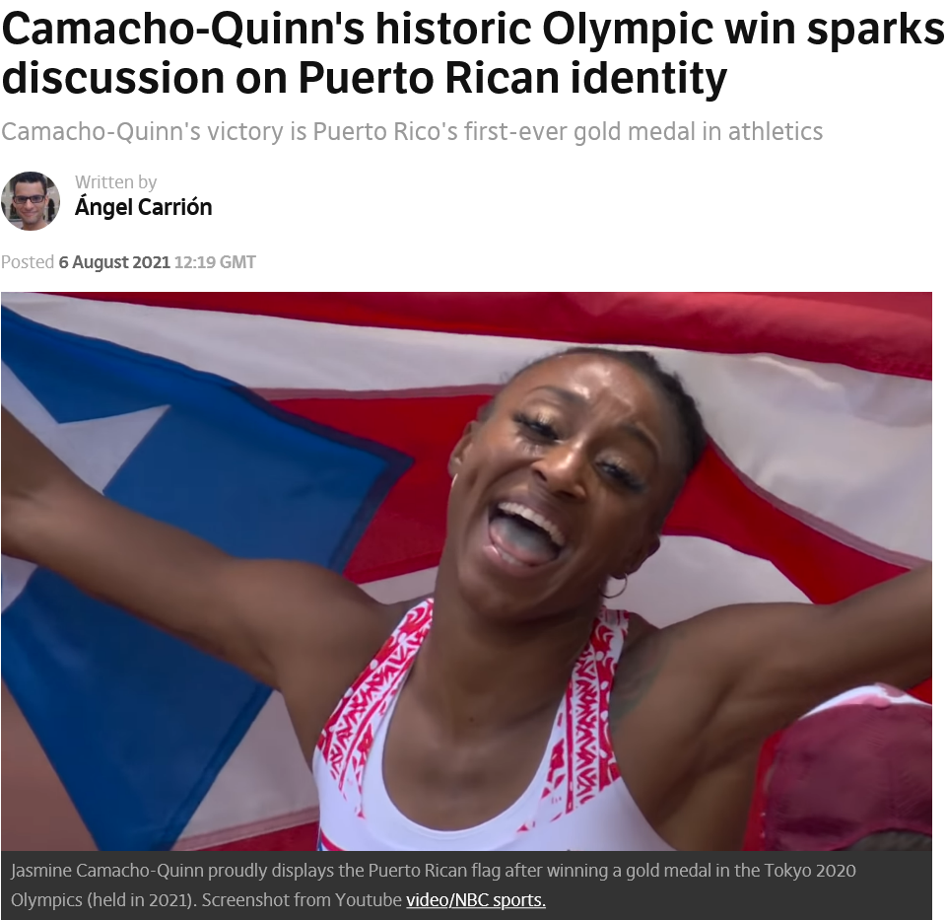
Constant Storm

Slide 3
Thinking about identity
What types of things make up our identity?
How does the past influence our identity?
How do we display or show our identity?
Based on the headlines – how might Puerto Rico’s identity be “stormy”?

Slide 4
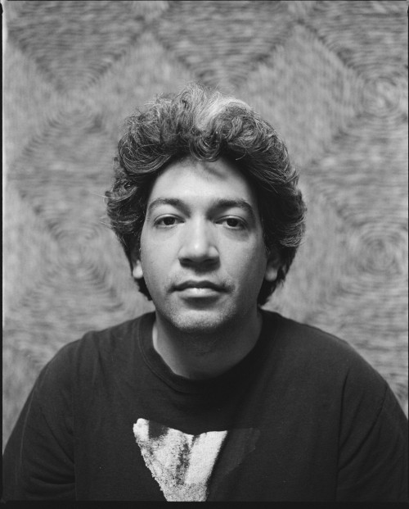
Jorge González Santos, artist
Jorge González Santos (Puerto Rico, b. 1981)
Lives and Works in Puerto Rico.
Jorge González’s recent work serves as a platform for the recuperation of marginalized vernacular material culture in an attempt to produce new narratives between the indigenous and the modern. The ongoing research that informs his practice draws material from the study of botany, ethnology, history, pedagogy, architecture and design.
Notes:
Iamge source: https://teatenerife.es/autor/gonzalez-santos-jorge/740

Slide 5
Origins of Puerto Rican cultural identity
What do you see?
What do you hear?
What did you learn?
How might this story become a part of Puerto Rican identity?

Slide 6
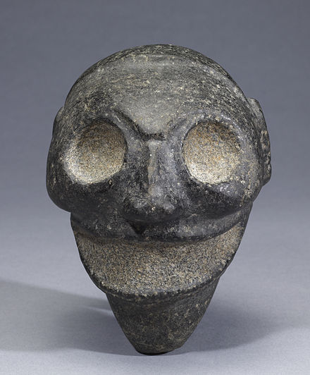
Cultural Masks Around the World
Let’s Explore!
Second Face Museum of Cultural Masks
This Photo by Unknown Author is licensed under CC BY-SA

Slide 7
Masks by Jorge González Santos
The series entitled Toali , is named after Taíno carved stones used to acknowledge ancestral spirits and act as offering for crop cultivation.
Initial production of new works have resulted in limestone carvings and drawings representing these ancient carved stones, made from lampblack, a black pigment made from soot harvested in the studio.
They refer to photographic documentation made by archaeological investigations of the Caribbean in the early 20th century.

Slide 8
Masks & Identity
What do masks reveal about a society’s beliefs & customs?
What do masks reveal about YOUR beliefs & identity?
What symbols will I use?
What colors are meaningful to me?
What do I want my mask to say about me?

