Slide 1
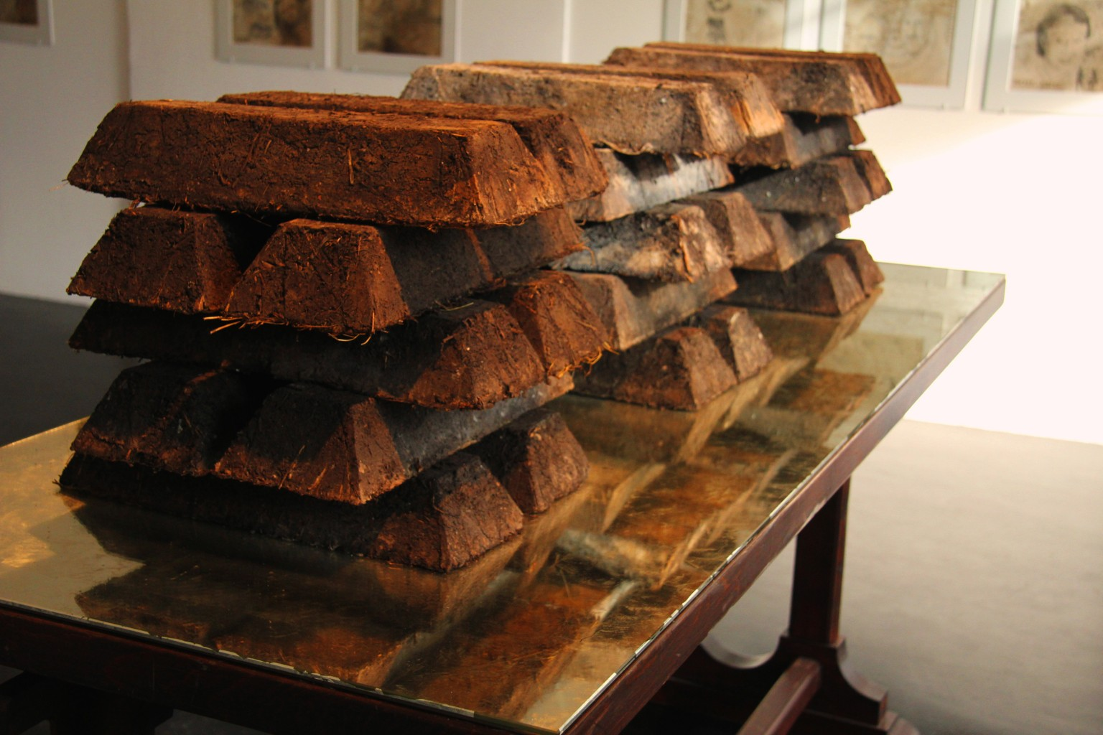
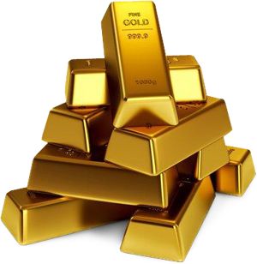
What are these?
Notes:
Project the first (on the left) image. Ask: What are these? What are they made of? What might they represent?
Animate the second image, of the gold bars. Ask: In what way(s) are the bars on the left similar/dissimilar to the bars on the right?
With Soil-erg (2012), artist Claire Pentecost proposes a new system of value based on living soil—a form of currency that anyone can make by composting. Shaped into serial discs and ingot forms that trouble modernist abstraction with use-value, the soil-erg is offered as a sustainable alternative to the petro-dollar, the marriage of the most influential commodity and the world’s most powerful (military-backed) currency. Heavy and fragile, living soil resists circulation and realizes its optimal value when produced and maintained within a context. Like all currency, the soil-erg is an abstraction, but at the same time its sheer embodiment is a reminder of the human and non-human effort that it costs to maintain life. In a wave of “new enclosures”, wealthy nations and international investment firms race to buy or lease land in poorer parts of the world in order to produce biofuels and other export crops. Outside the Ottoneum, in collaboration with Can YA Love Foundation, the project continues in the form of vertical pillars filled with soil for intensive vegetable production in dense, land-poor communities.

Slide 2
Soil-erg:
A new form of currency?
The art activism of Claire Pentecost

Slide 3
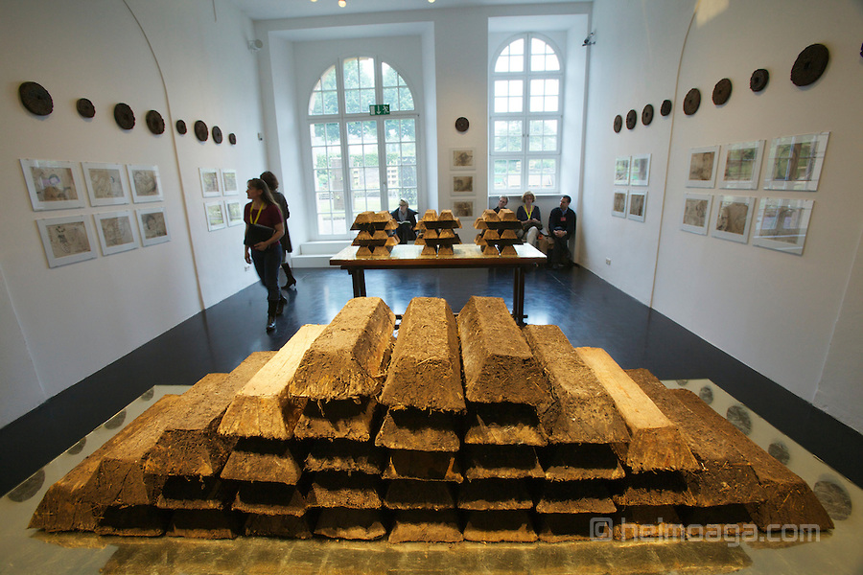
Claire Pentecost, Soil-erg (2012)
Notes:
With Soil-erg (2012), artist Claire Pentecost proposes a new system of value based on living soil—a form of currency that anyone can make by composting. Shaped into serial discs and ingot forms that trouble modernist abstraction with use-value, the soil-erg is offered as a sustainable alternative to the petro-dollar, the marriage of the most influential commodity and the world’s most powerful (military-backed) currency.
In Claire Pentecost’s words:
The center of the installation itself is the proposal of a new system of value based on living soil. To formalize this I have created a series “sculptural” objects from handmade
soil, or compost. These represent units of a new currency, the soil-erg.

Slide 4
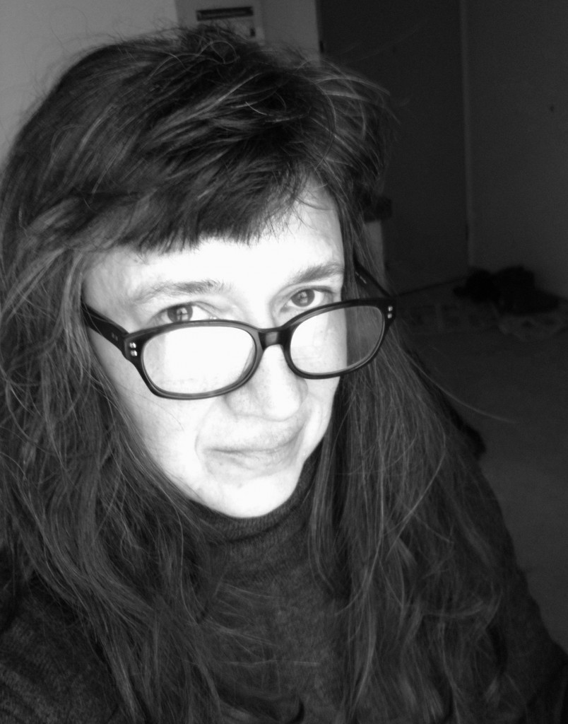
Claire Pentecost
Claire Pentecost is an artist/activist focusing on food, soil, and bio-engineering
born 1956, Baltimore, Maryland
education: B.A., Smith College; M.F.A., Pratt Institute, NY
Professor of photography at SAIC (School of the Art Institute of Chicago)
Notes:
Image source: http://fnewsmagazine.com/2015/01/5-questions-claire-pentecost/

Slide 5
Soil-erg (2012)
Four components:
I. Sculptural Objects: proposal of a new system of value based on living soil
II. Drawings: oversize paper “currency” depicting historical figures, soil-food web creatures, and environmentalists
III: Inside Installation: cabinet with composting bed and list of “land grabs”
IV: Outside Installation: vertical growing systems
Notes:
Give an overview of the individual components first. The following slides describe each more specifically.

Slide 6
I. Sculptural Objects

Slide 7
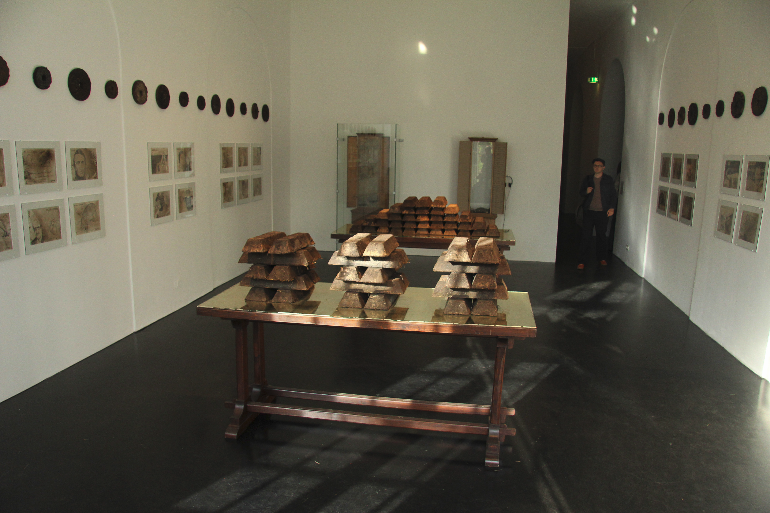
Notes:
In Claire Pentecost’s words:
The important thing about the soil-erg is that it both is and is not an abstraction. Symbolically it refers to a field of value, but that value is of a special nature: it must be
produced and maintained in a context. It is completely impractical to circulate it. It is heavy, and because of the loose structure required of good soil, it falls apart. It only
makes sense when located in a place.

Slide 8
II. Drawings
Notes:
43 drawings in the form of oversized paper bills, but unlike standardized paper currency each one is unique. The drawings are loosely of three categories: those depicting historical figures that have made critical contributions to an ecological understanding of agriculture; those depicting non-human creatures of the soil-food web; and others picturing writers, philosophers, anthropologists, artists, etc., who have broadened and complicated our understanding of ourselves as part of a wider ecological system.

Slide 9
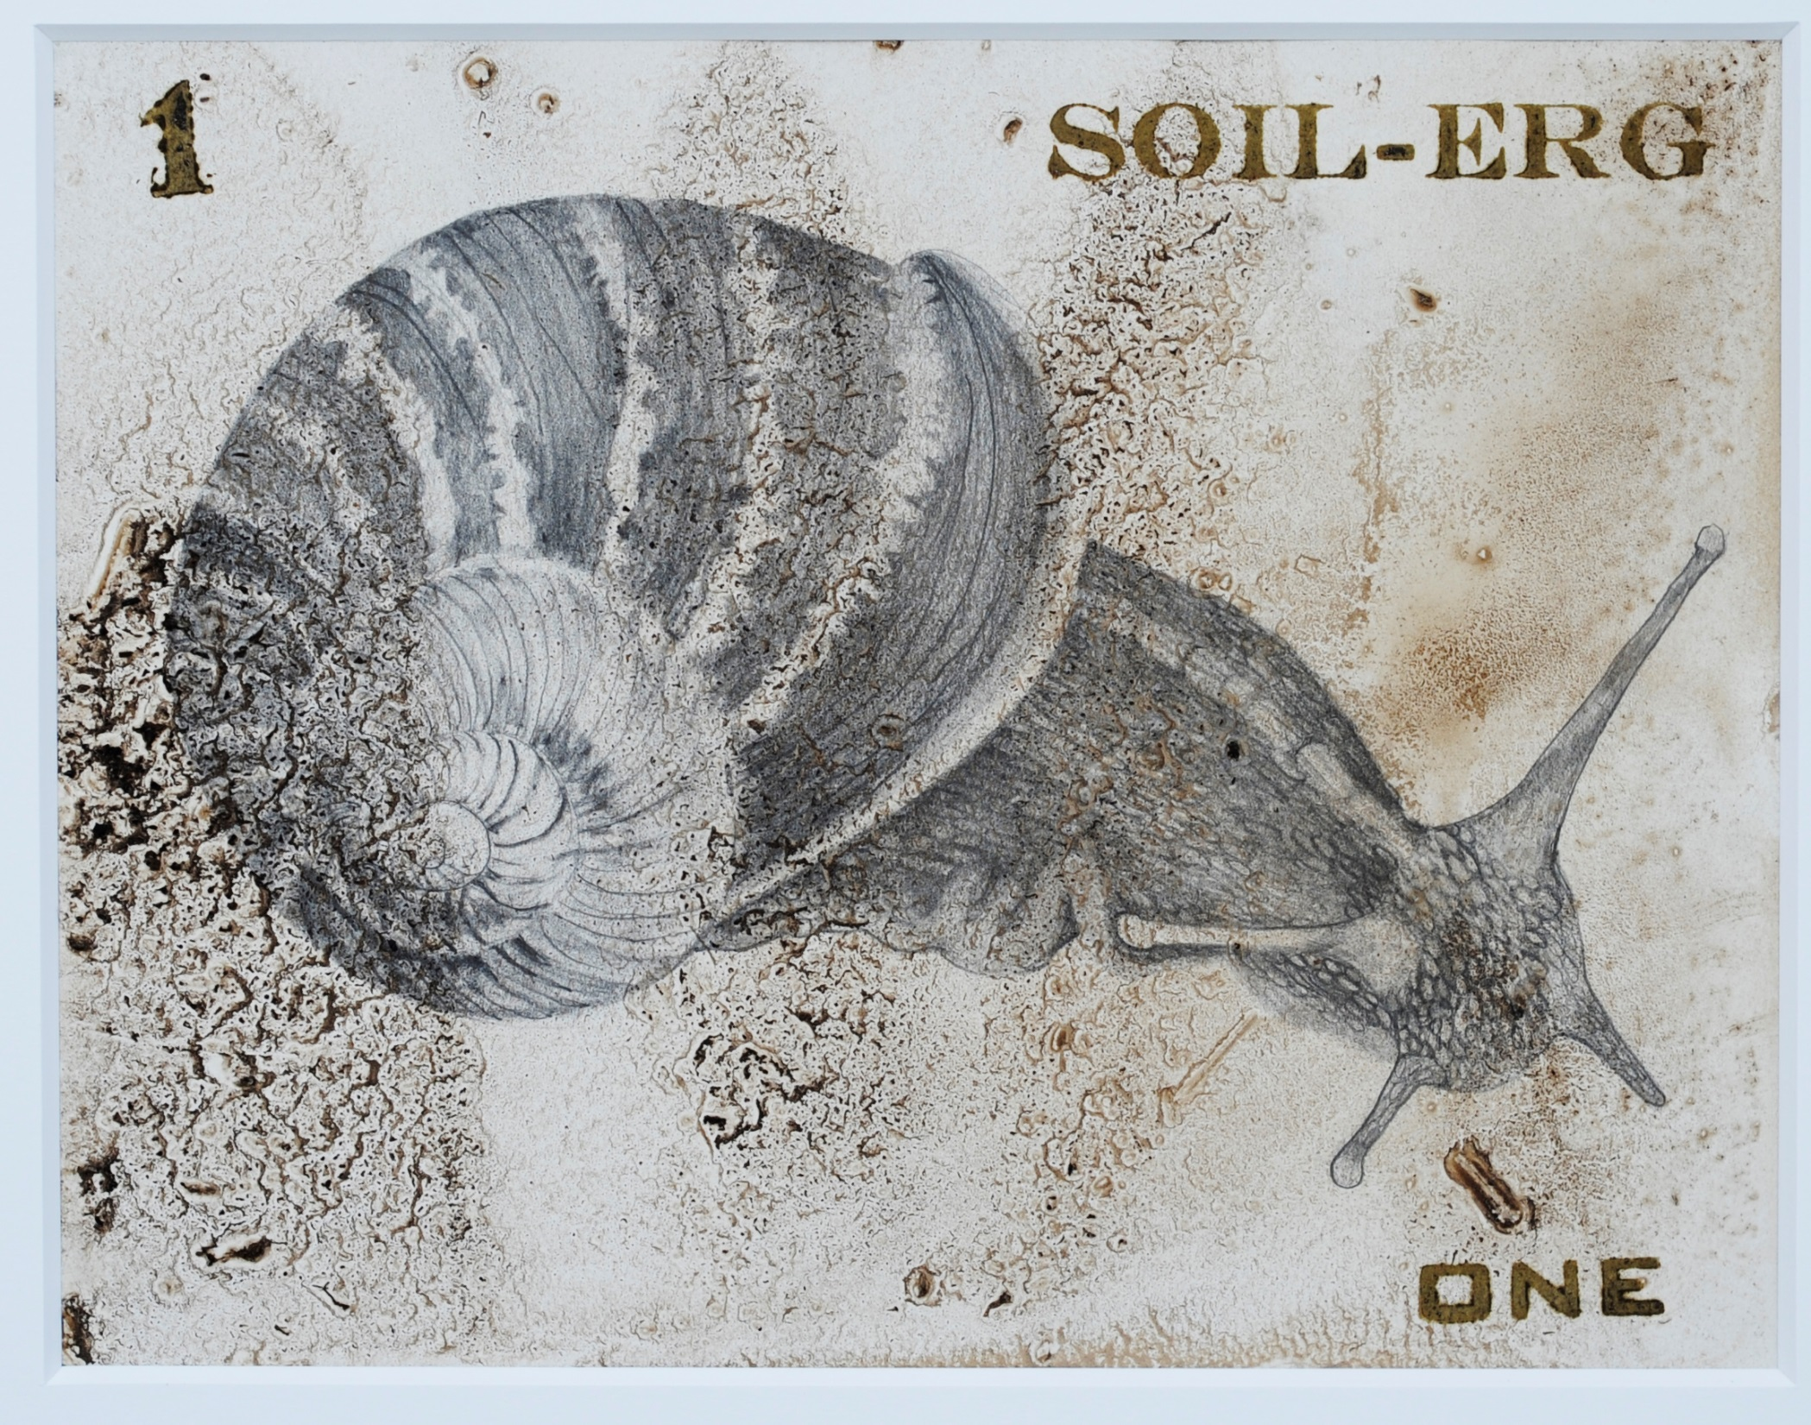
Notes:
The drawings depict creatures from the soil–food web, historical figures who have played significant roles in our understanding of ecological approaches to agriculture, and people whose thinking has helped to decenter the human, enhancing our understanding of ourselves as one part of an immense and complex ecology.
This drawing is of a snail, an important creature in the soil-food web.

Slide 10
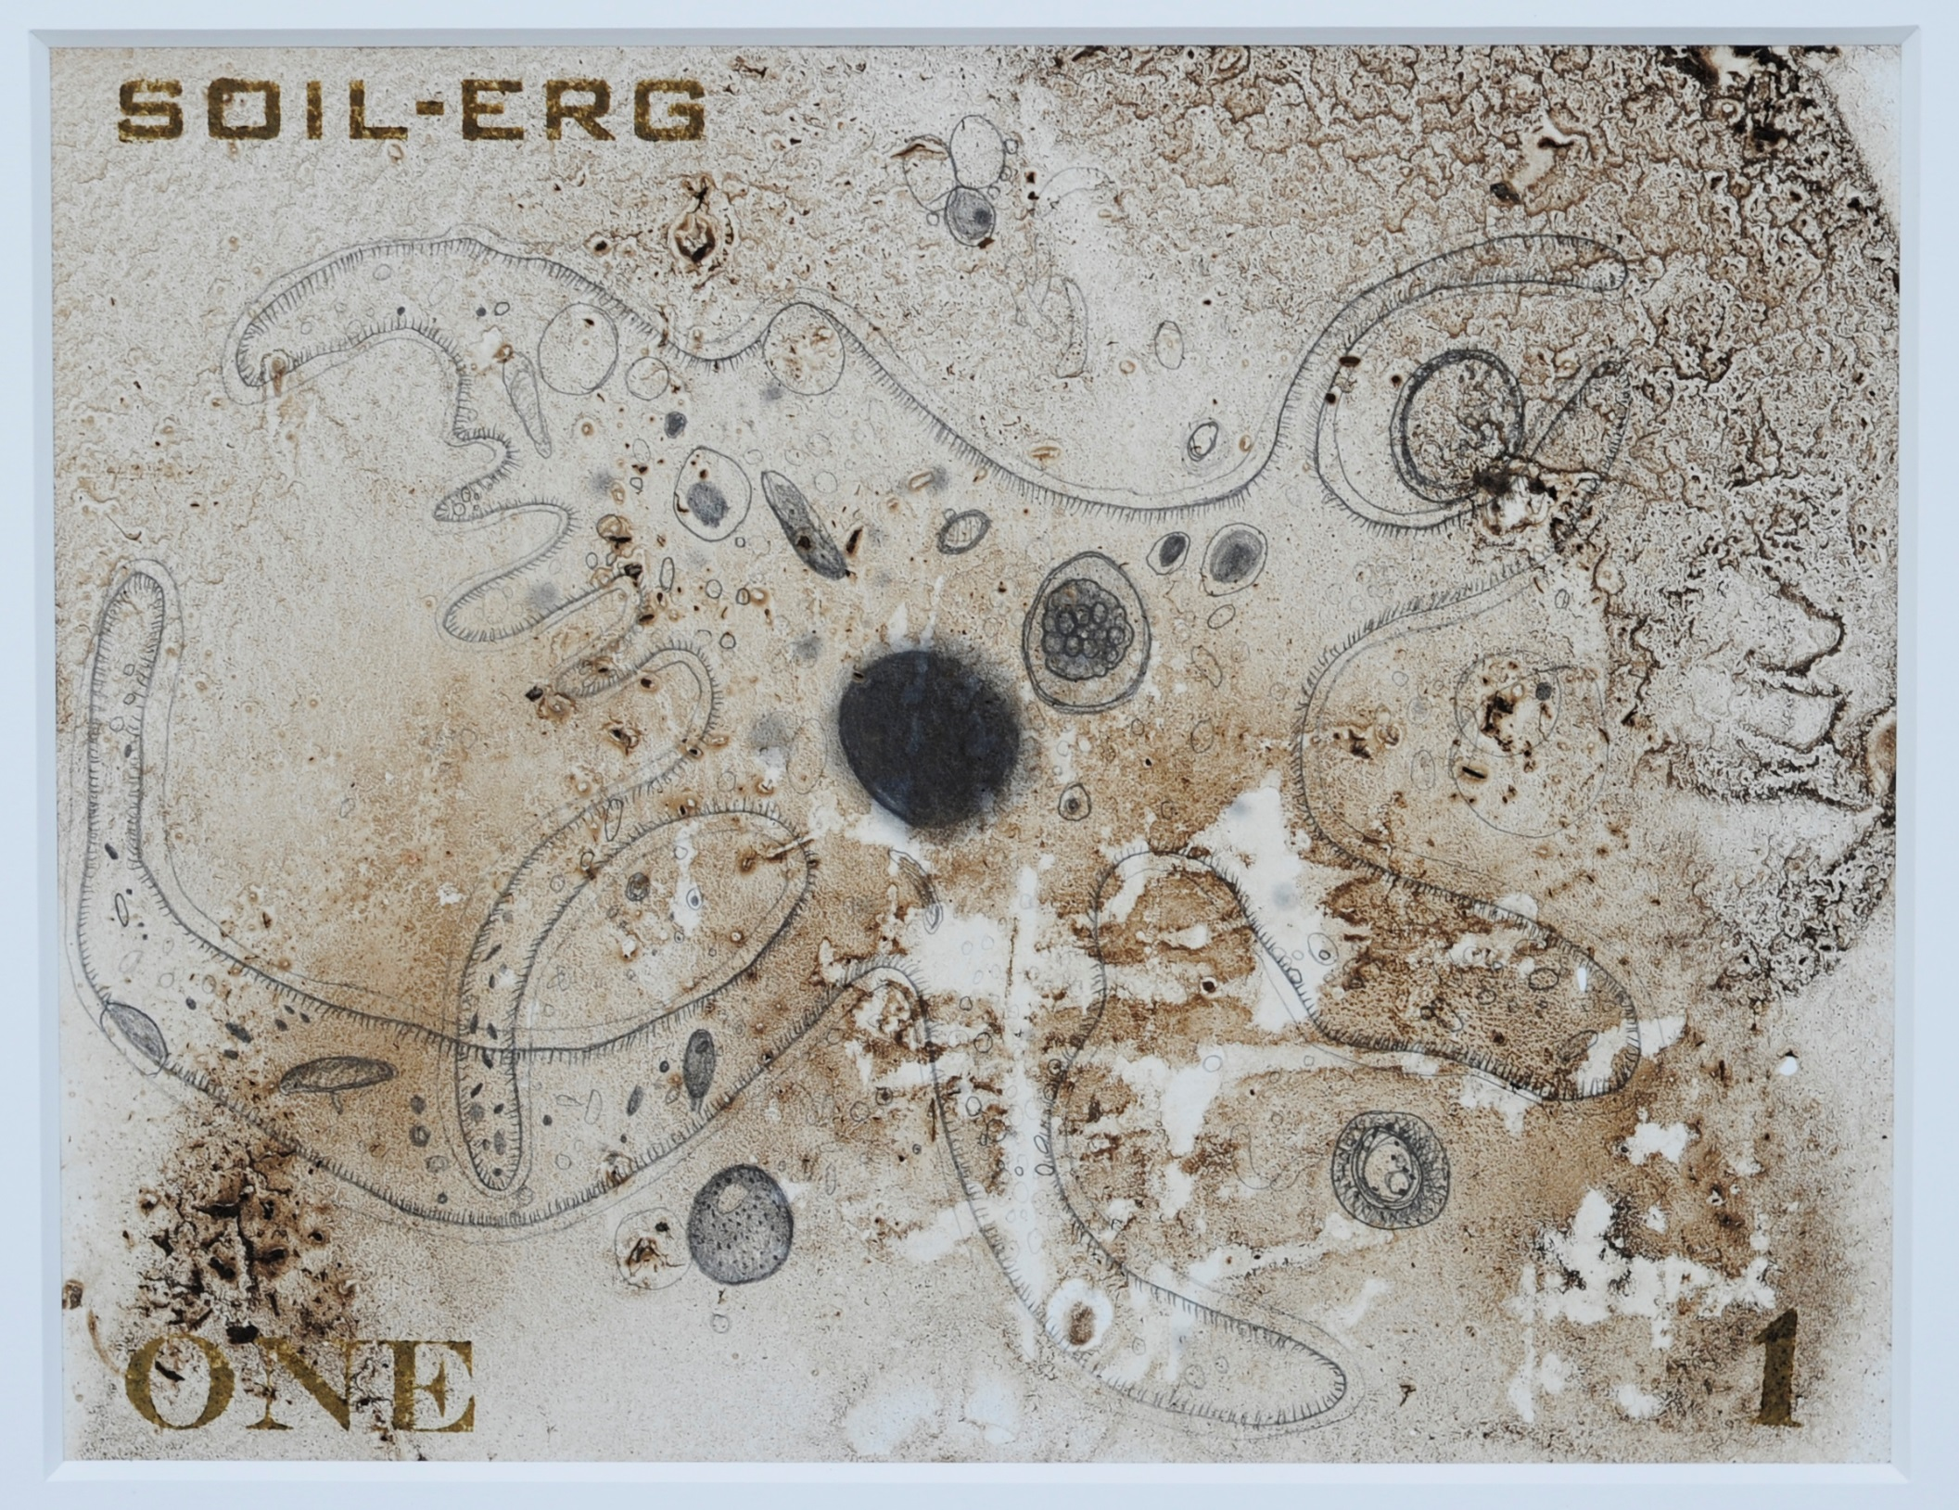
Notes:
Amoeba
Single-celled animal that is ever-present in our environment.

Slide 11
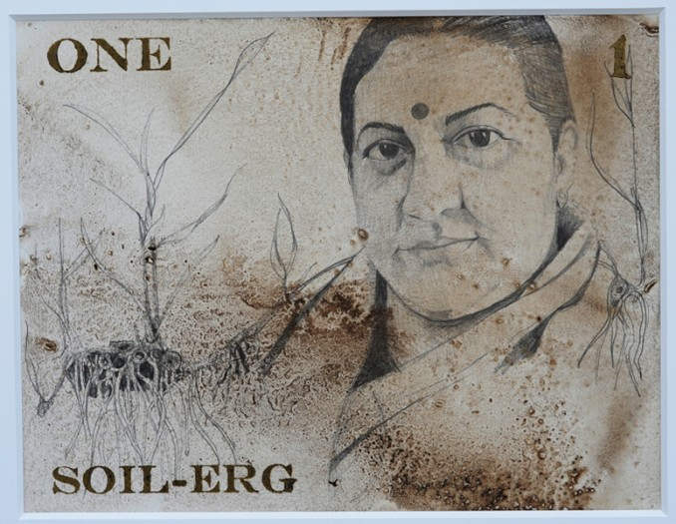
Notes:
Vandana Shiva (b. 1952) Indian physicist, author, eco-feminist and environmental activist

Slide 12
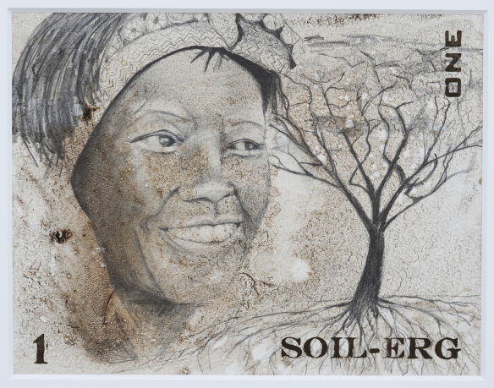
Notes:
Kenyan environmental and political activist Wangari Maathai (1940-2011)

Slide 13
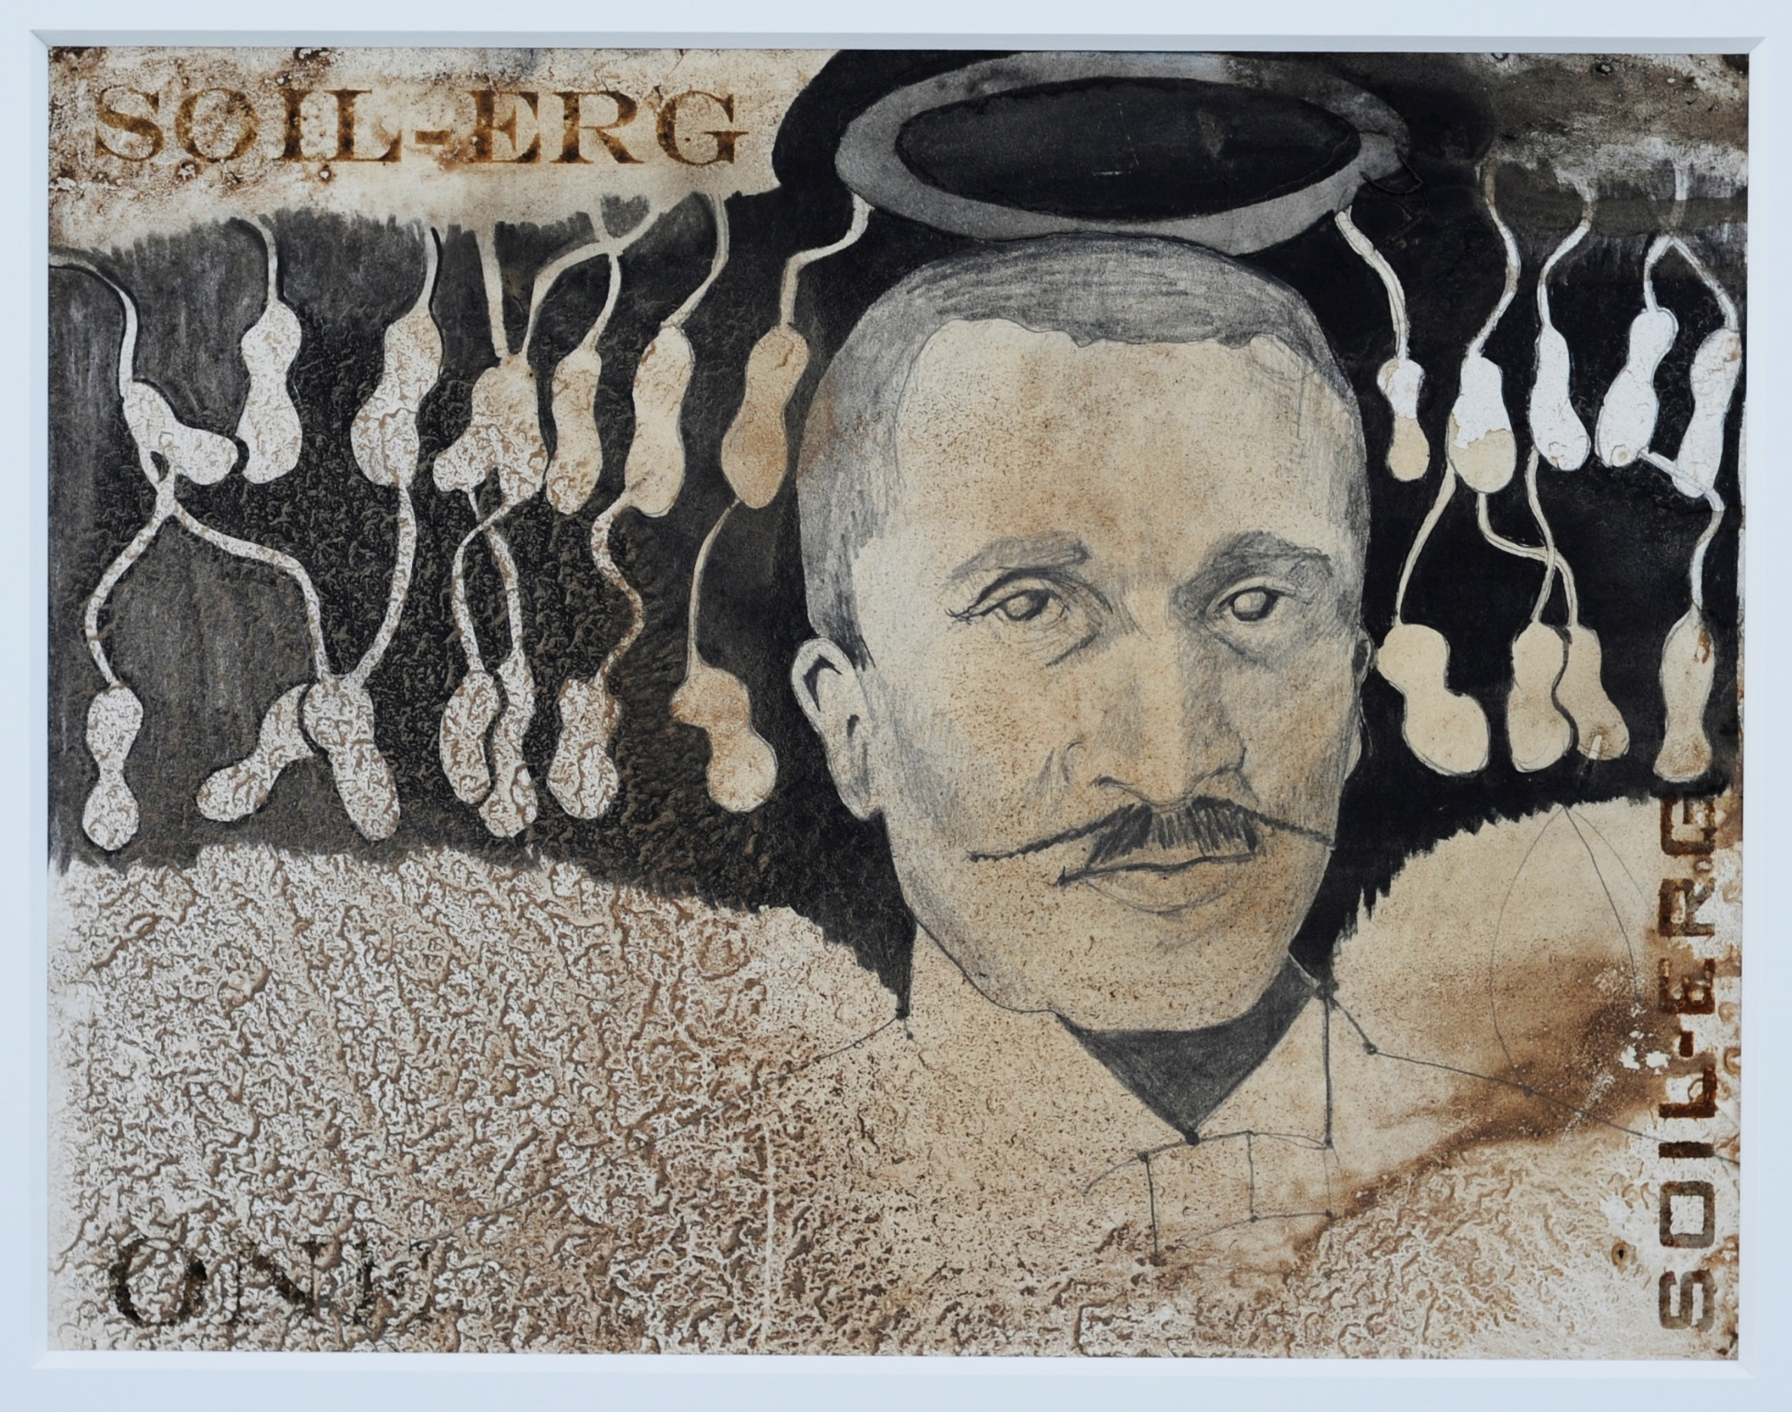
Notes:
George Washington Carver: Born into slavery, he was an American botanist , inventor, and environmentalist Carver conducted numerous research studies on alternative crops such as cotton, sweet potatoes, and his most famous, peanuts (which are depicted in this drawing). His findings not only aided farming techniques, but also contributed to the nutrition of farm families.

Slide 14
III. Inside Installation

Slide 15
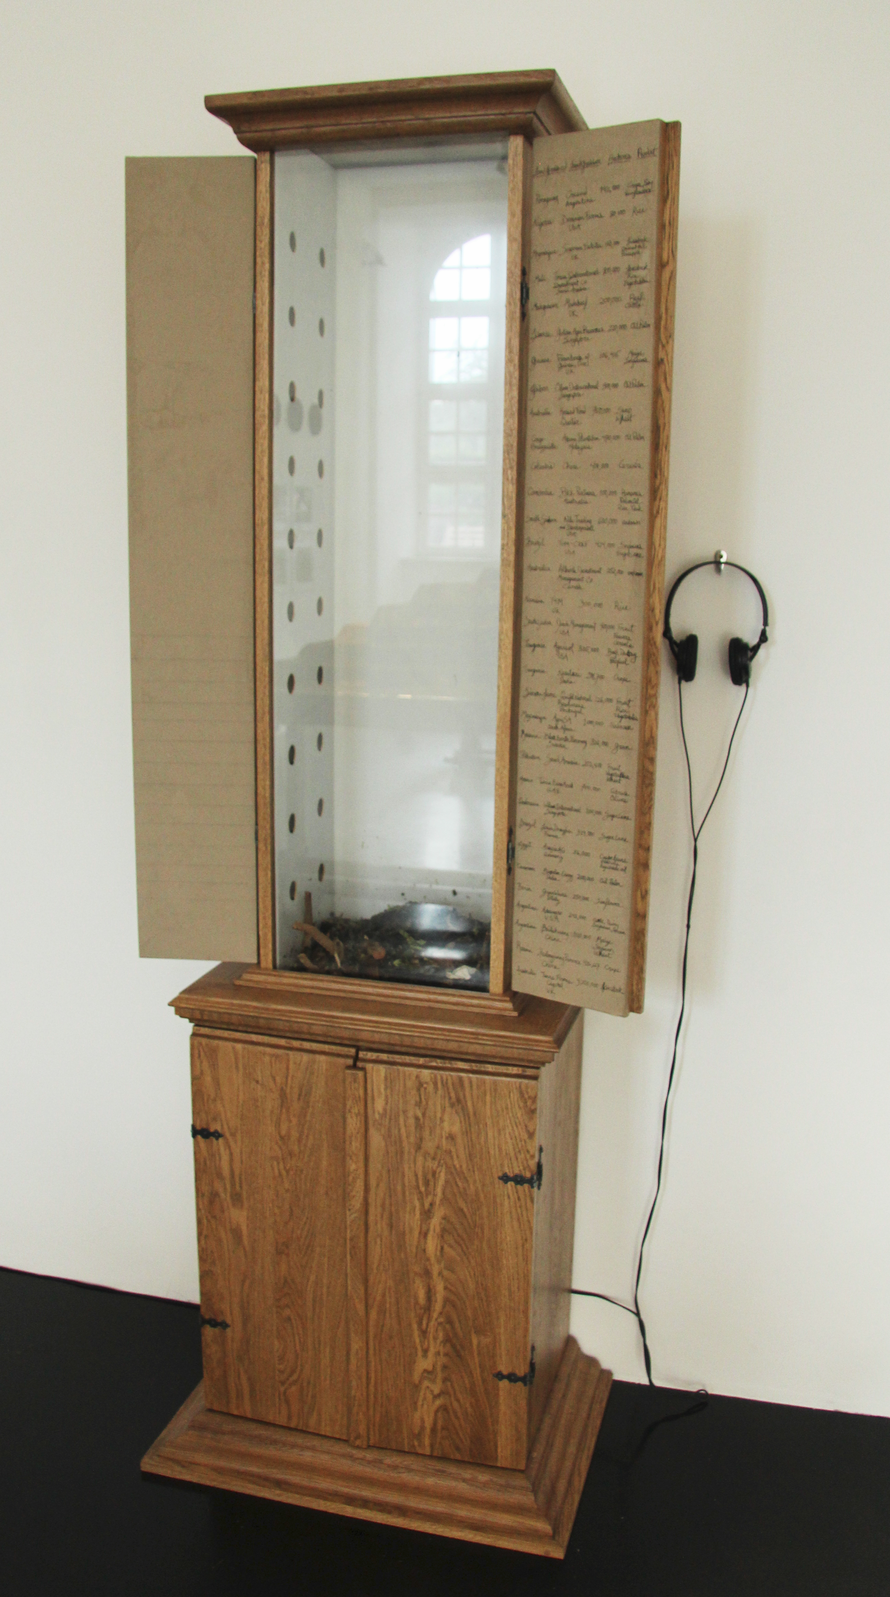
Notes:
In Claire Pentecost’s words: For the d(13) installation of the project in the Ottoneum Museum, I borrowed a piece from the museum’s collection, the Richelsdorfer Mountain Cabinet, 1783. This
constitutes the oldest geological section of Hessia; the upper compartment opens to show the vertical section of the sequence of layers of the Richelsdorfer mountain chain with
natural stone material. This geological profile is an incunabulum of the geological research in Hessia in the 18th century. The mountain was originally cut in a search for
copper. Stone was extracted for this cabinet by miners of the mountain, and I used the cabinet to reference the age of extraction. Beside the original cabinet I placed a copy of it. But in the new piece the doors open to reveal a worm composting bed with living worms. The worms were fed kitchen scraps throughout the 100 days of d(13) and in that time were literally making soil. I think of
this soil-making machine as a representative of a new era of restoration of the earth’s surface. Written on the inside of the cabinet’s doors are the details of just a few of the land deals
currently being referred to as “land grabs” in which sovereign nations, corporations and investment funds are buying or leasing huge tracts of arable land in Africa, Asia and
South America to grow crops for export. See http://farmlandgrab.org/ and http://oaklandinstitute.org

Slide 16
IV. Outside Installation

Slide 17
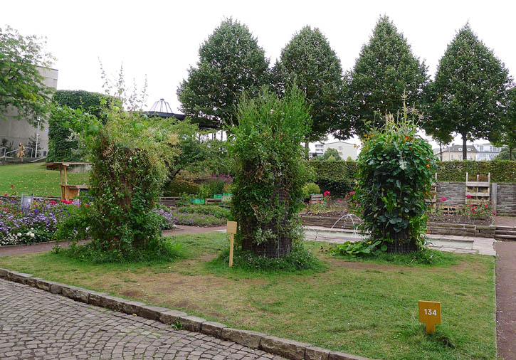
Notes:
In Claire Pentecost’s words:
Can soil be distinguished from real estate? If people can make soil from organic waste but they have no land, what are the options for growing food in limited space? To address this question… I constructed vertical growing systems. These pillar forms are simple and inexpensive and easily adapted to dense urban spaces where people are land-poor.

Slide 18
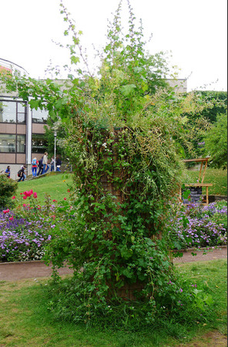

Slide 19
Claire Pentecost:
Other works

Slide 20
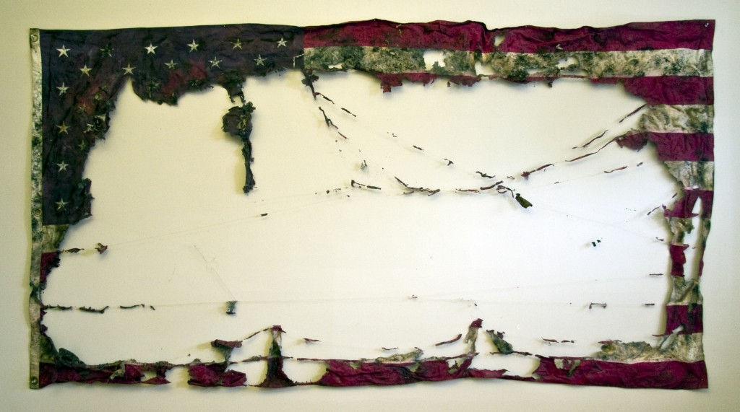
Proposal for a New American Agriculture (2012)
Notes:
Source: https://portlandflag.org/2015/02/17/claire-pentecost/
For Proposal for a New American Agriculture, she placed a US flag in a composting bin in her basement in Chicago, removing and photographing it after worms had transformed most of it into soil.
One reading of this striking image: It points to the unsustainability and inevitable collapse of America’s corporate-dominated, anti-environmental economy and ecology, and the need to weave a new American fabric to fill this gap.

Slide 21
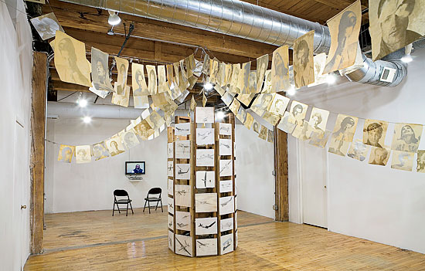
Victoryland…You, I Shall Answer Your Letter (2010)
Notes:
CLAIRE PENTECOST. VICTORYLAND…YOU, I SHALL ANSWER YOUR LETTER, 2010
The School of the Art Institute professor protests globalization in her work, exemplified by a 2010 “Threewalls” installation of drawings that questions America’s use of drones (above).
Image source: http://www.chicagomag.com/Chicago-Magazine/June-2013/Threewallss-Shannon-Stratton-Predicts-Breakout-Artists
PHOTO BY CLARE BRITT

Slide 22
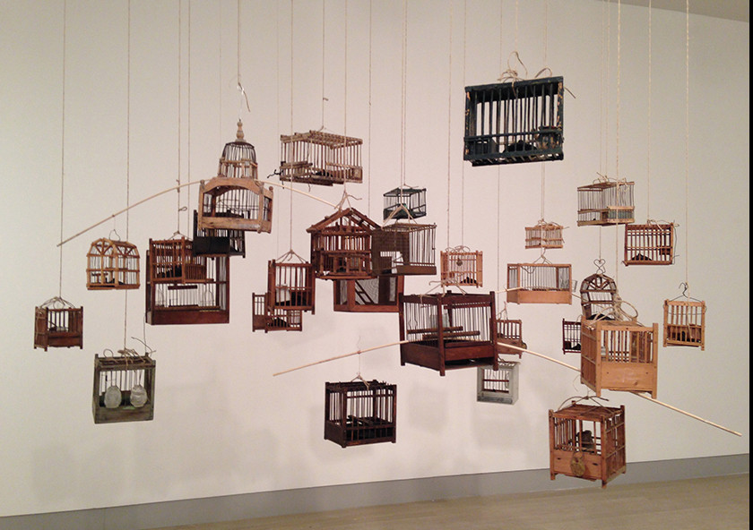
for the body without organs to sense (2014)
Notes:
Claire Pentecost. “for the body without organs to sense,” 2014 (coal miner’s canary cages, cast petroleum coke, wire, thread, canary)
Composed of miners’ canary cages, molded petroleum breasts and an actual canary, the piece is an indictment of humans’ inability to wean themselves from fossil fuels and the ecological destruction it has entailed.

Slide 23
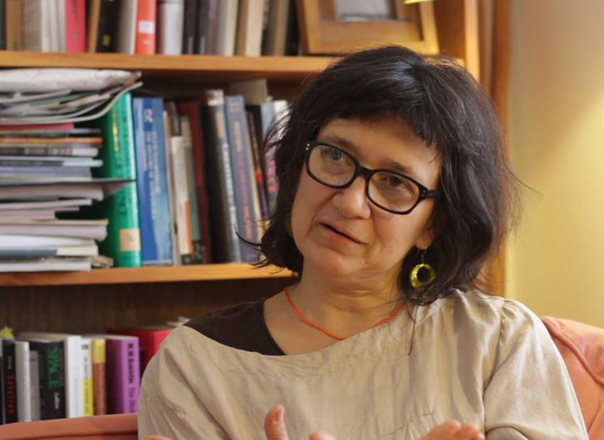
“It becomes increasingly clear that no one is going to save us and we have to work together to experiment with new ways of being in the world. For this we have to return knowledge to the realm of the social by producing knowledge collectively.”
--- Claire Pentecost, 2012
Notes:
Image source: http://www.diysect.com/learninginpublic/
Ask for volunteers to paraphrase the meaning of Pentecost’s quote. Are there any examples from modern society of people working together to produce new knowledge? If you had the opportunity to collectively work on a social ill, what problem would it be?

