Slide 1
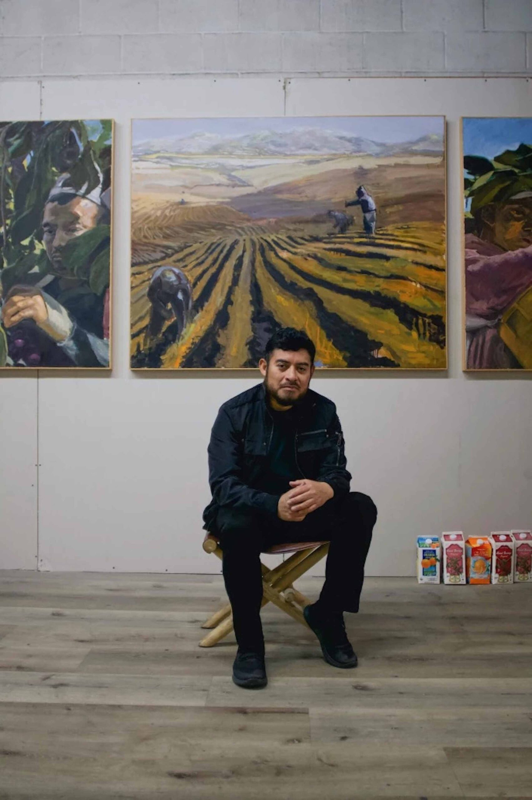
Superfresh:
The Art of Narsiso Martínez
Notes:
Source of image: https://dedalusfoundation.org/programs/fellows-recipients/fellow/narsiso-martinez/

Slide 2
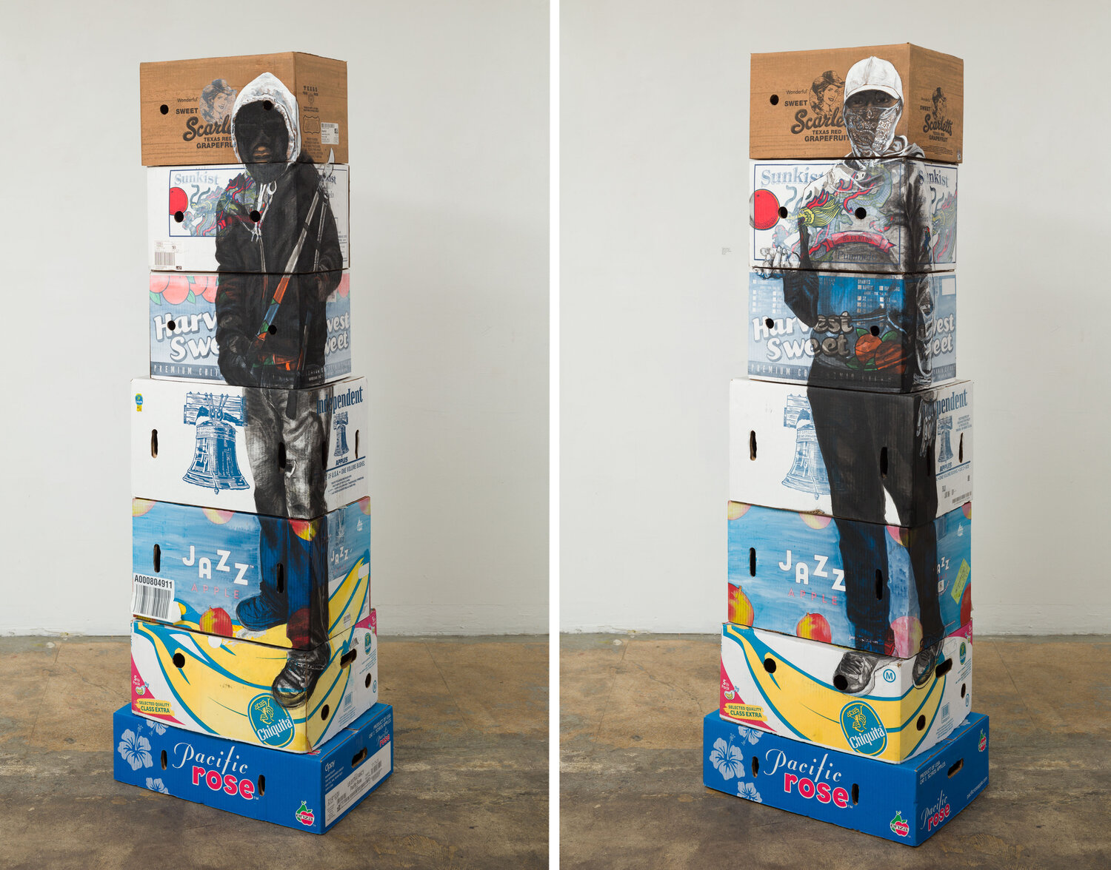
Notes:
Source of art images: https://www.cjamesgallery.com/exhibitions/superfresh
Magic Harvest, 2019

Slide 3
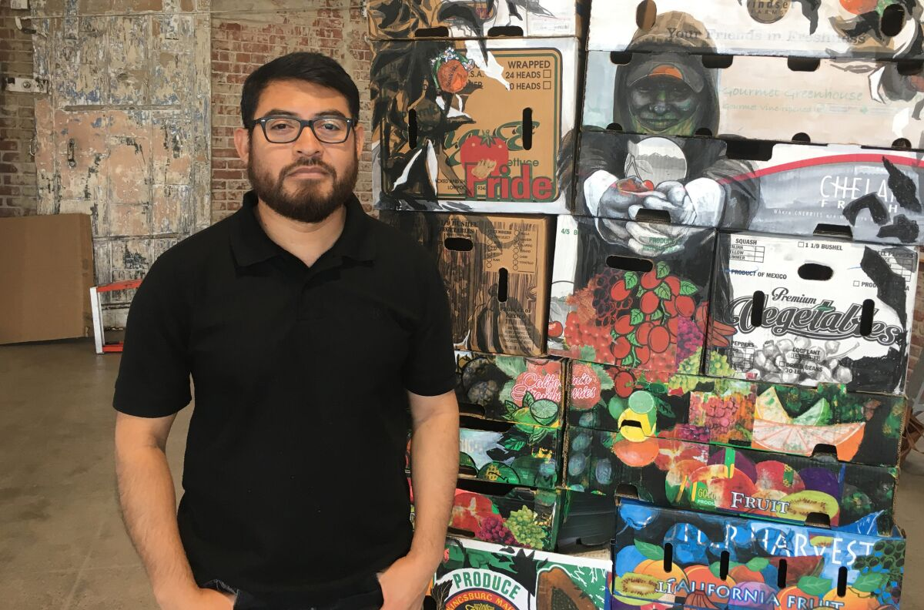
Narsiso Martínez
Notes:
Long Beach artist Narsiso Martinez poses with his 3-D display, Friends in Freshness, at the Long Beach Museum of Art Downtown.
(Christi Carras / Los Angeles Times)
Source: https://www.latimes.com/entertainment-arts/story/2019-09-11/narsiso-martinez-long-beach-museum-of-art-downtown

Slide 4
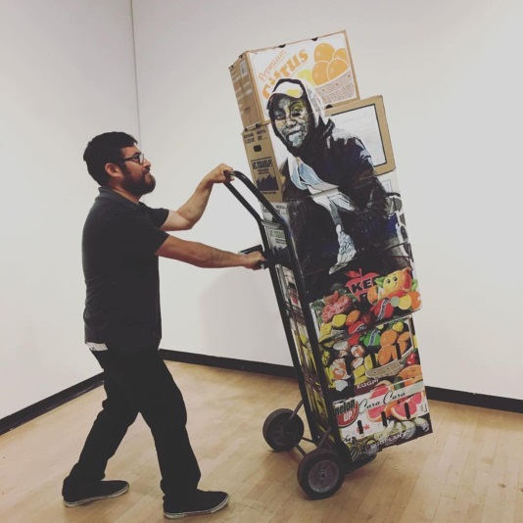
Technique and Media
Work centers on the lives and labor of migrant agricultural workers
Was an agricultural worker to pay for his art school education
Drawings and mixed media installations
Often uses discarded produce boxes from grocery stores
Notes:
Often uses discarded produce boxes from grocery stores as a physical embodiment of the agricultural process, tangibly referencing and acknowledging the migrant experience and presence.
Source: https://www.uncsa.edu/kenan/art-restart/narsiso-martinez.aspx
Image: https://www.lbma.org/narsiso-martinez/

Slide 5
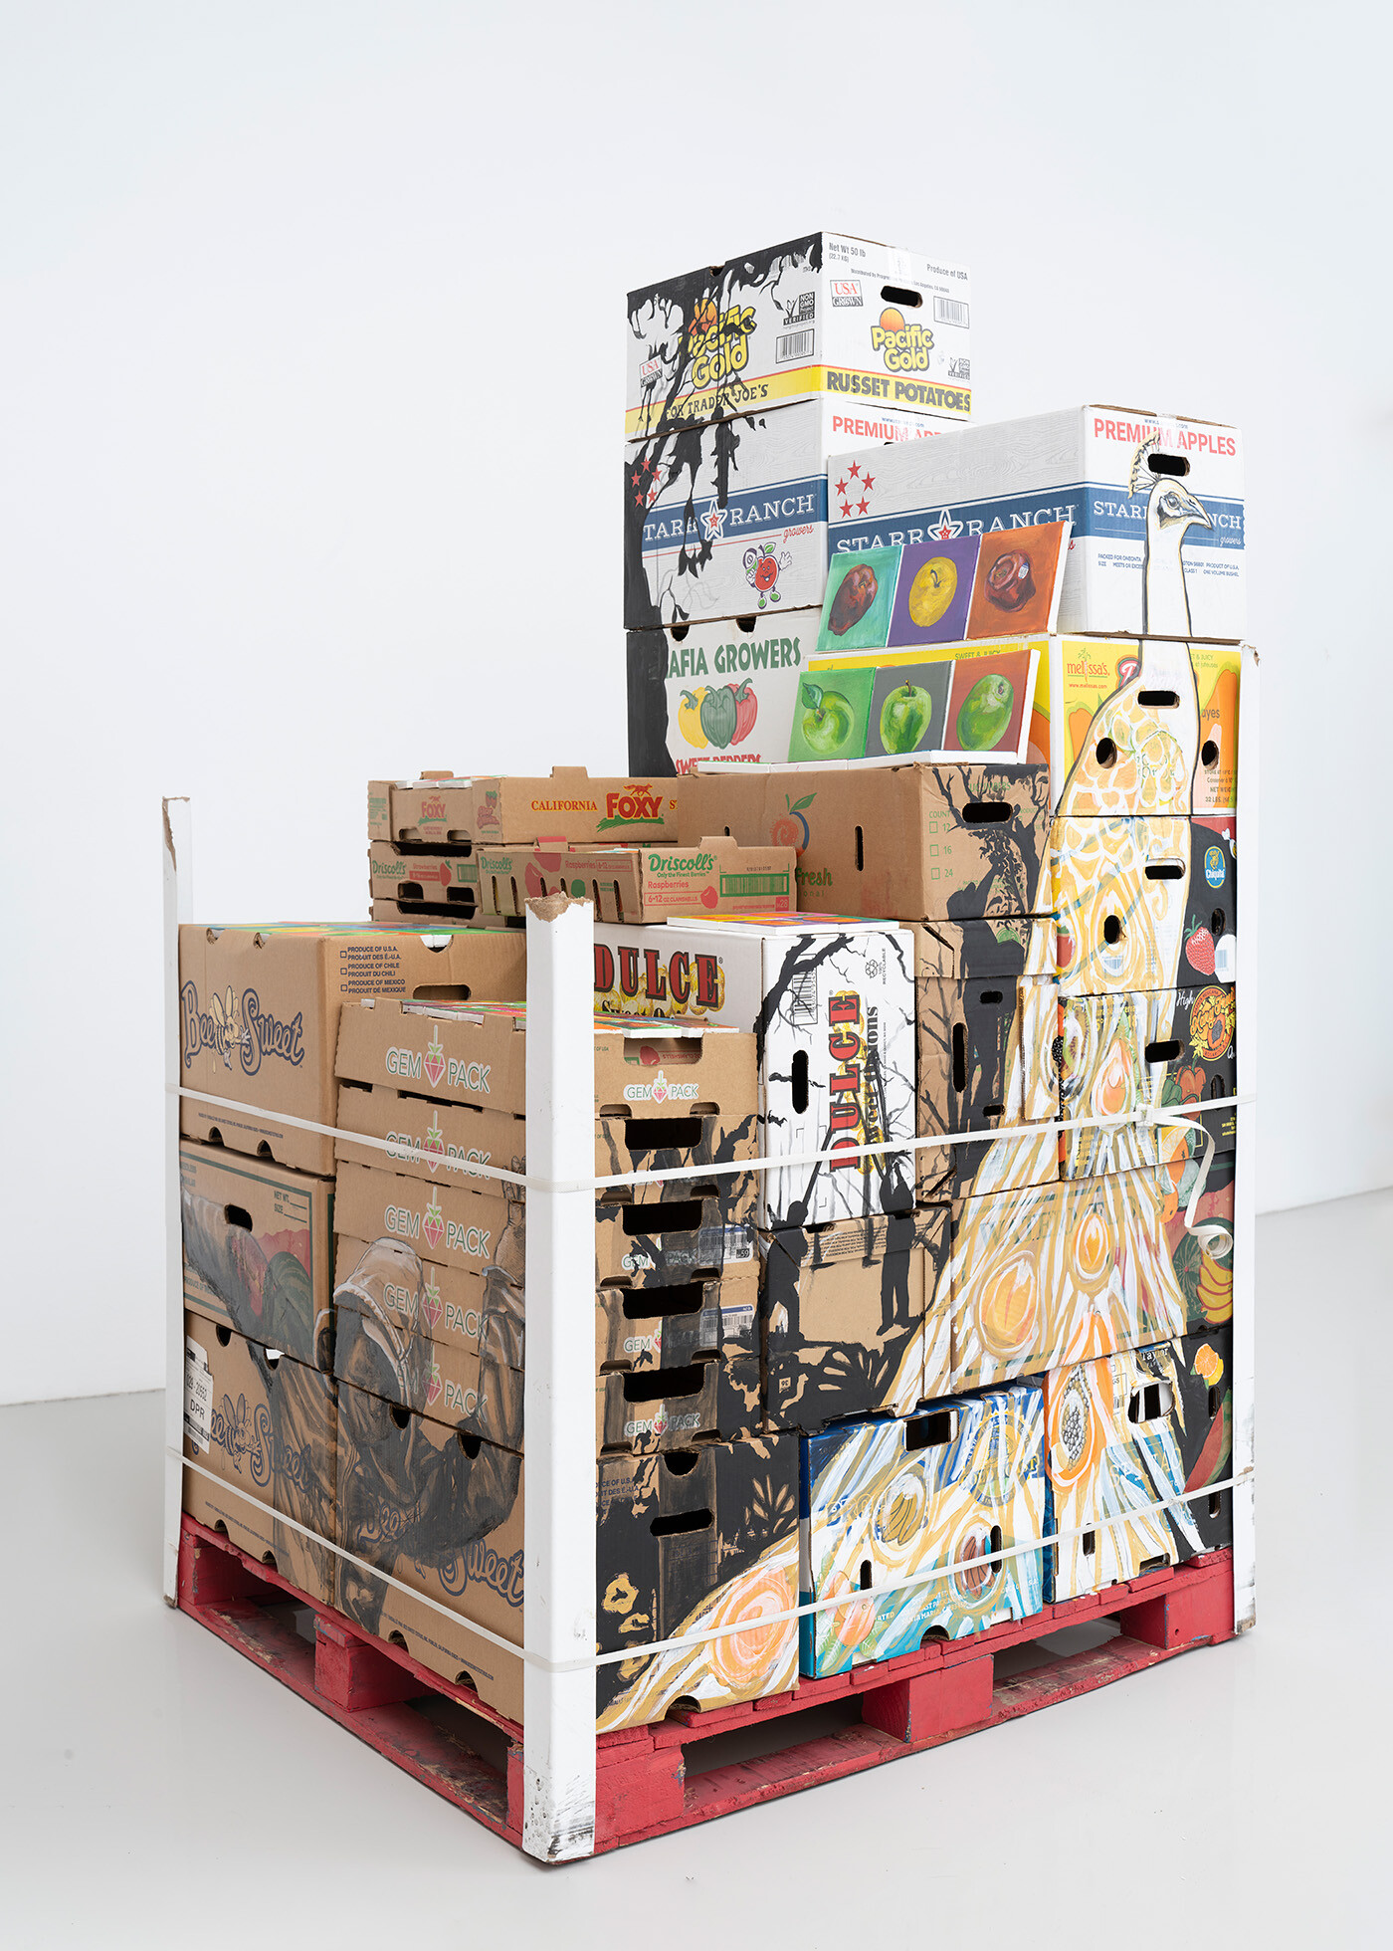
Found Objects
Objects not usually considered art material
When grouped together, the finished work may be called “assemblage”
The objects are often modified, but undisguised
When the are not modified, they are known as “ready-mades”
The artist decides how and why to use the object in an artwork
Notes:
Artwork: Pacific Gold, 2021
These agricultural boxes are “ready-mades” but also reflect more than what they actually are as the objects.
Ask: Why do you think Martinez chooses to work with these specific boxes?

Slide 6
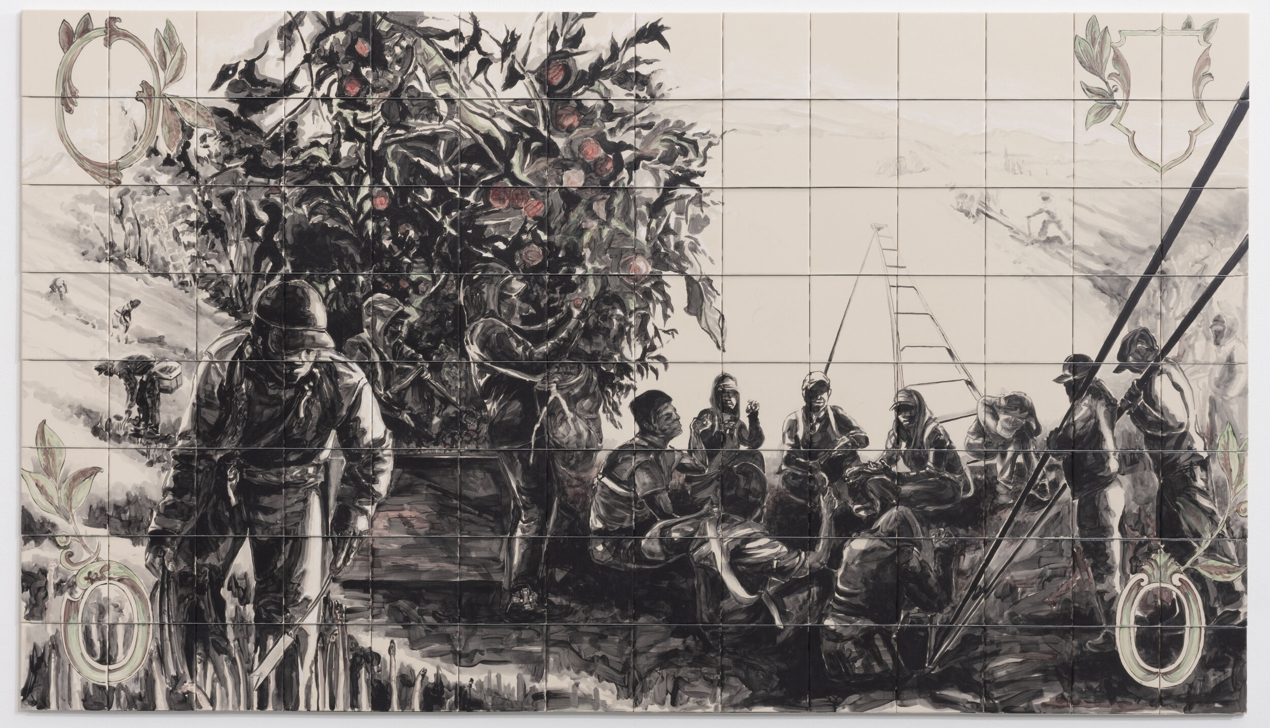
Notes:
Philosophy in the Fields, 2020

Slide 7
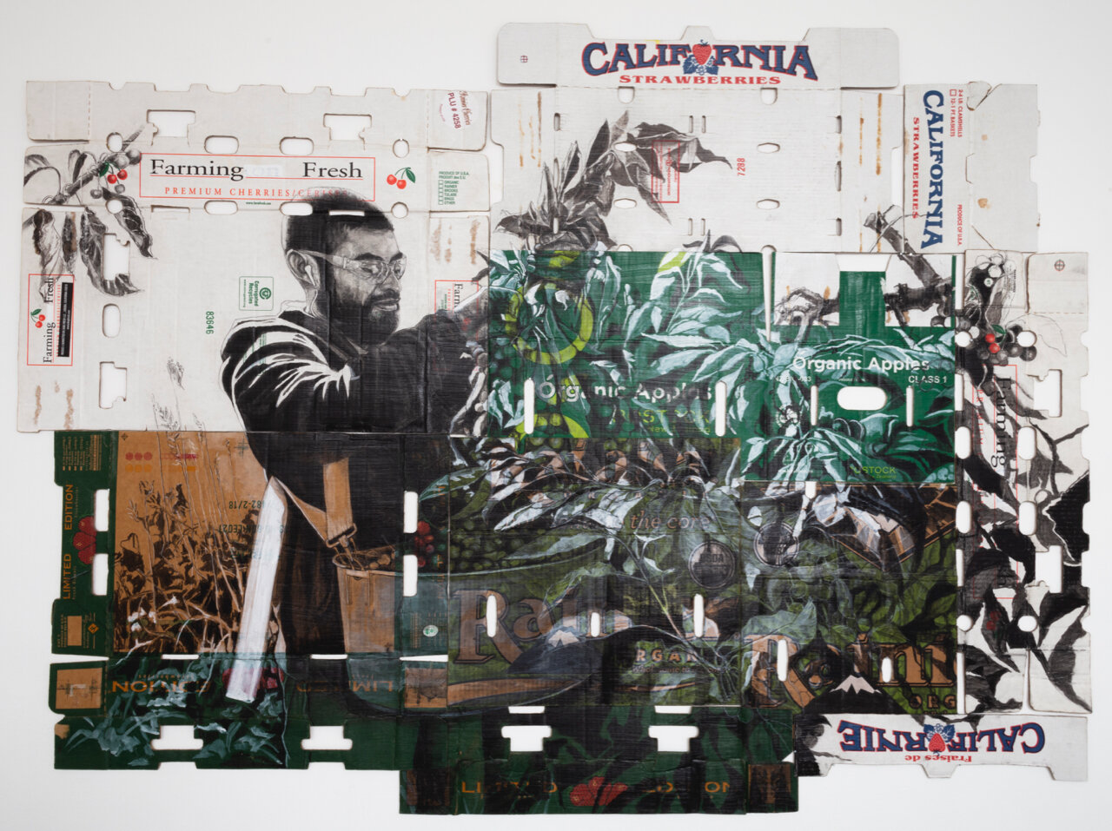
Notes:
Self-Portrait in La Cherry (with Strawberry Fields Forever in the Background), 2020

Slide 8
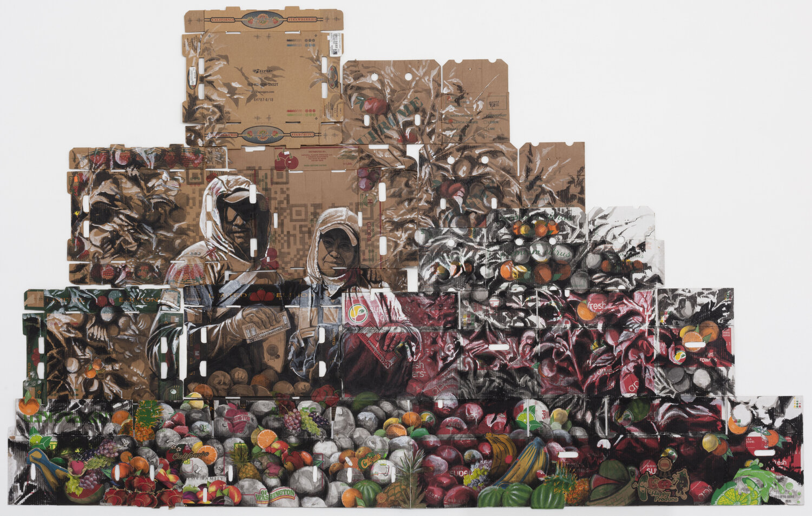

Slide 9
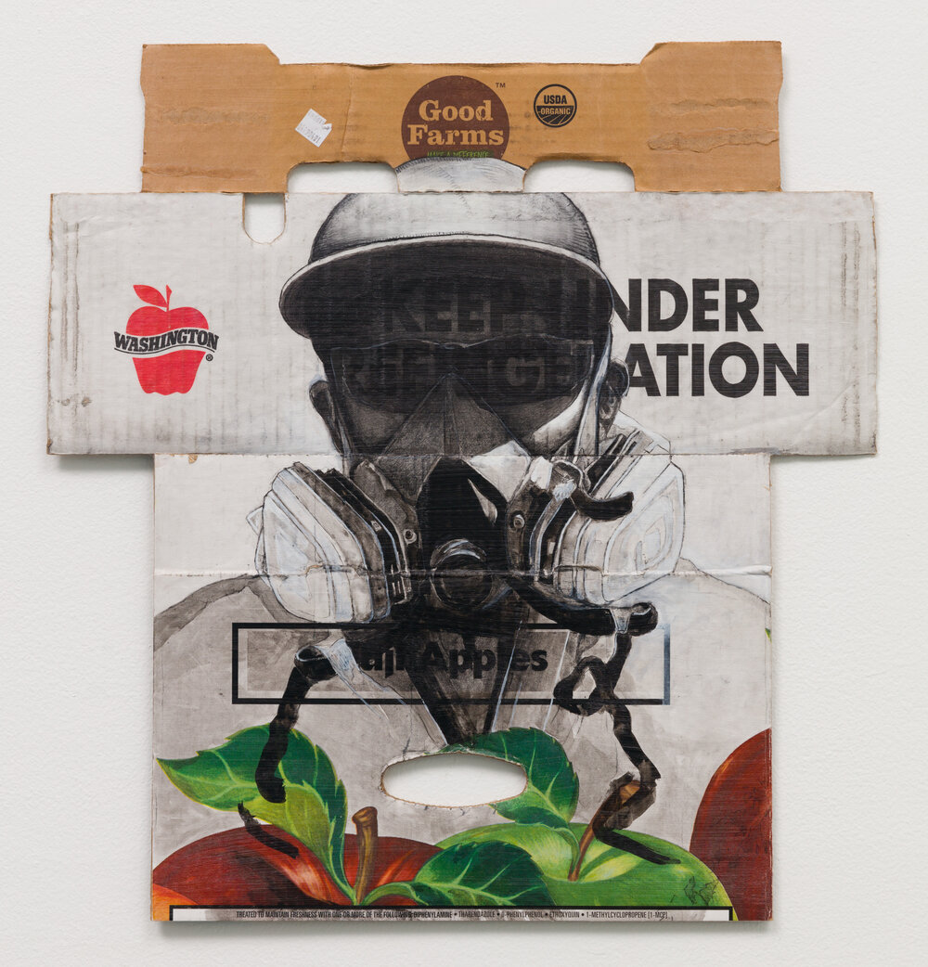
Notes:
Good Farms, 2020

Slide 10
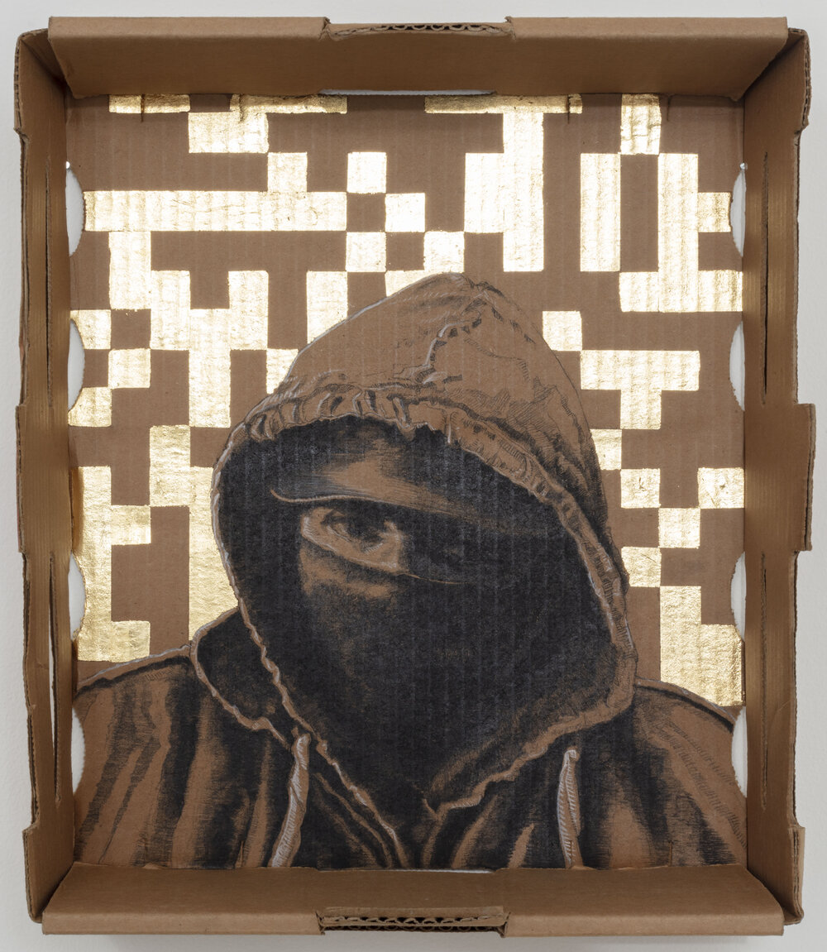
Notes:
The Harvester, 2020

Slide 11
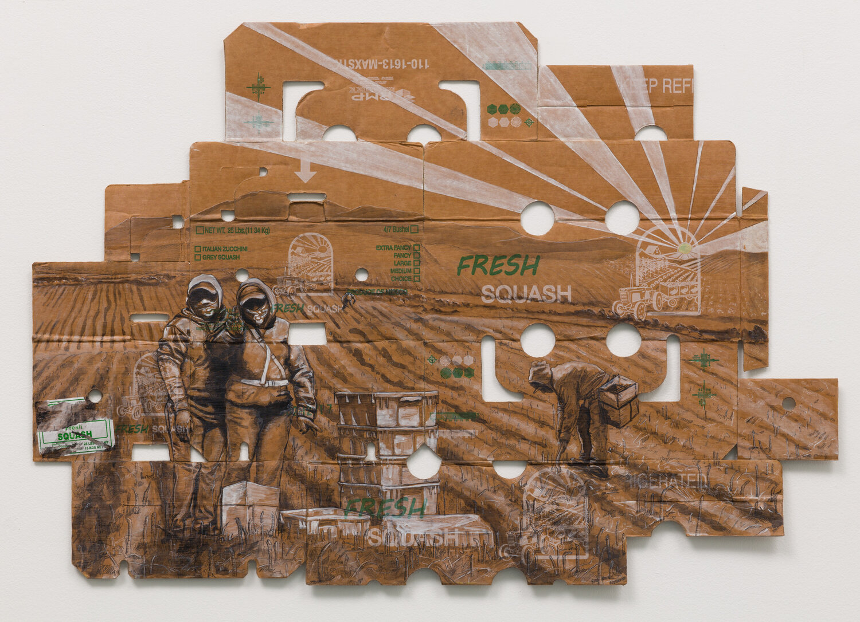
Notes:
In the Fresh, 2020

Slide 12
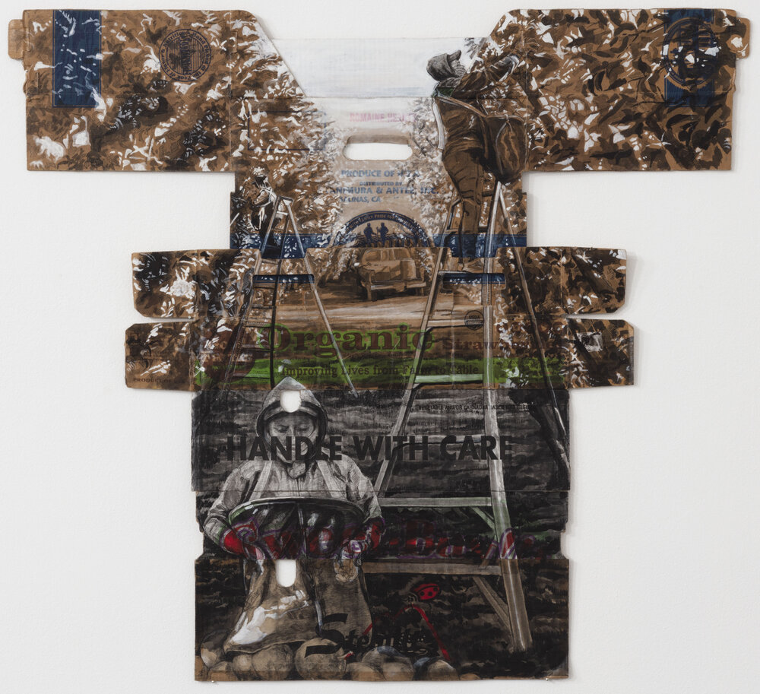
Notes:
With Care, 2020

Slide 13
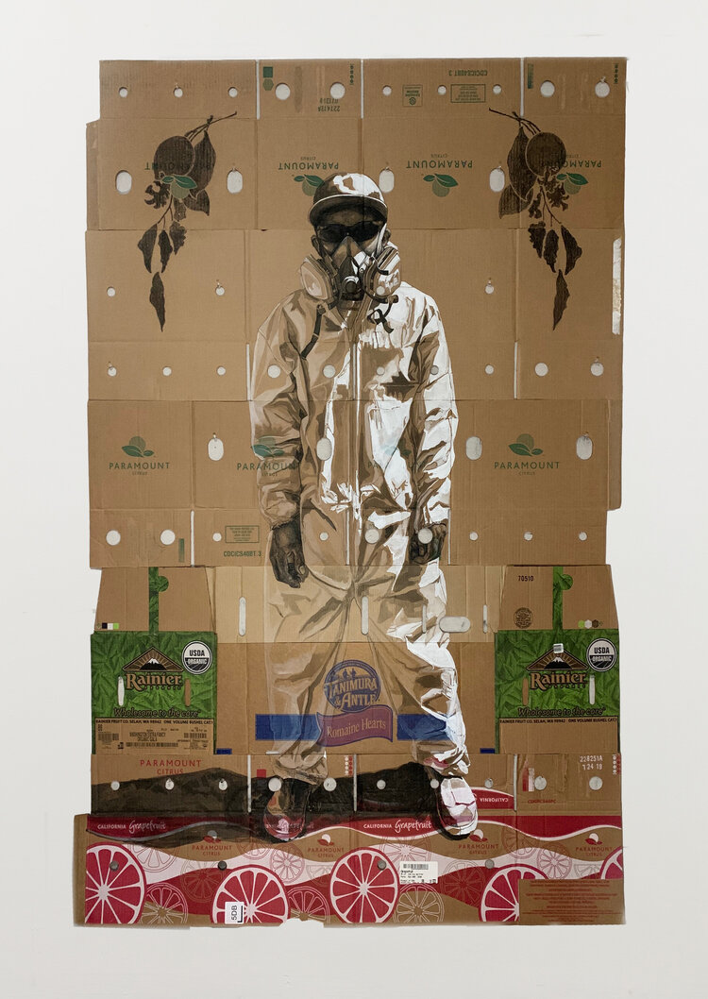
Notes:
The Weed Sprayer, 2020

Slide 14
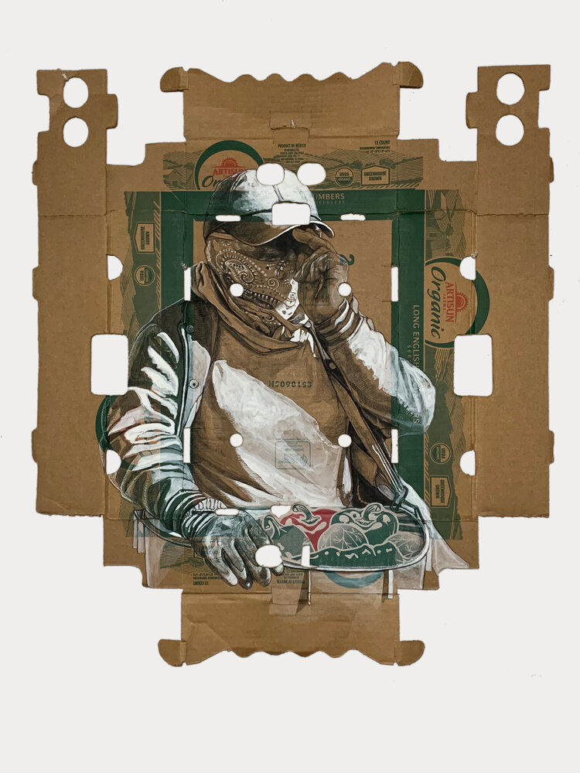
Notes:
Green Organic, 2020

Slide 15
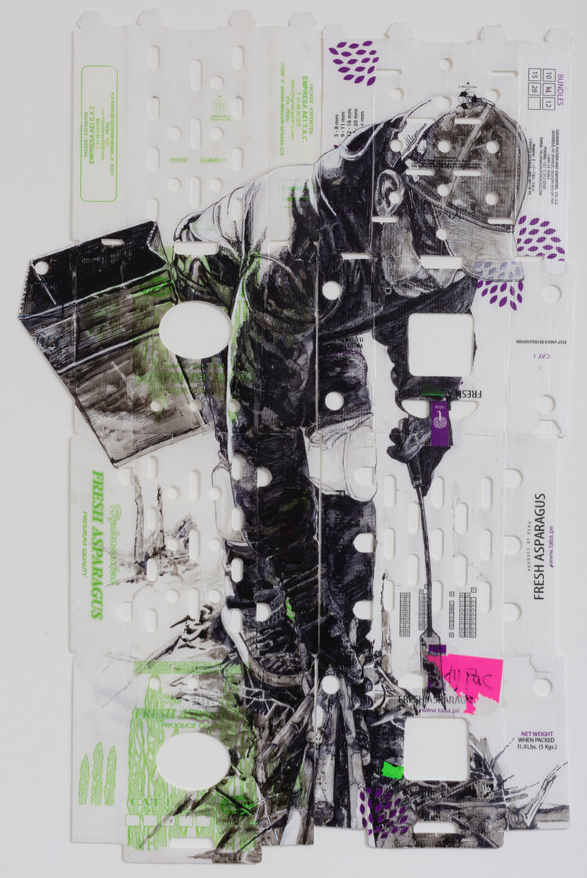
Notes:
Fresh Cut (The Beginning of a New Day), 2020

Slide 16
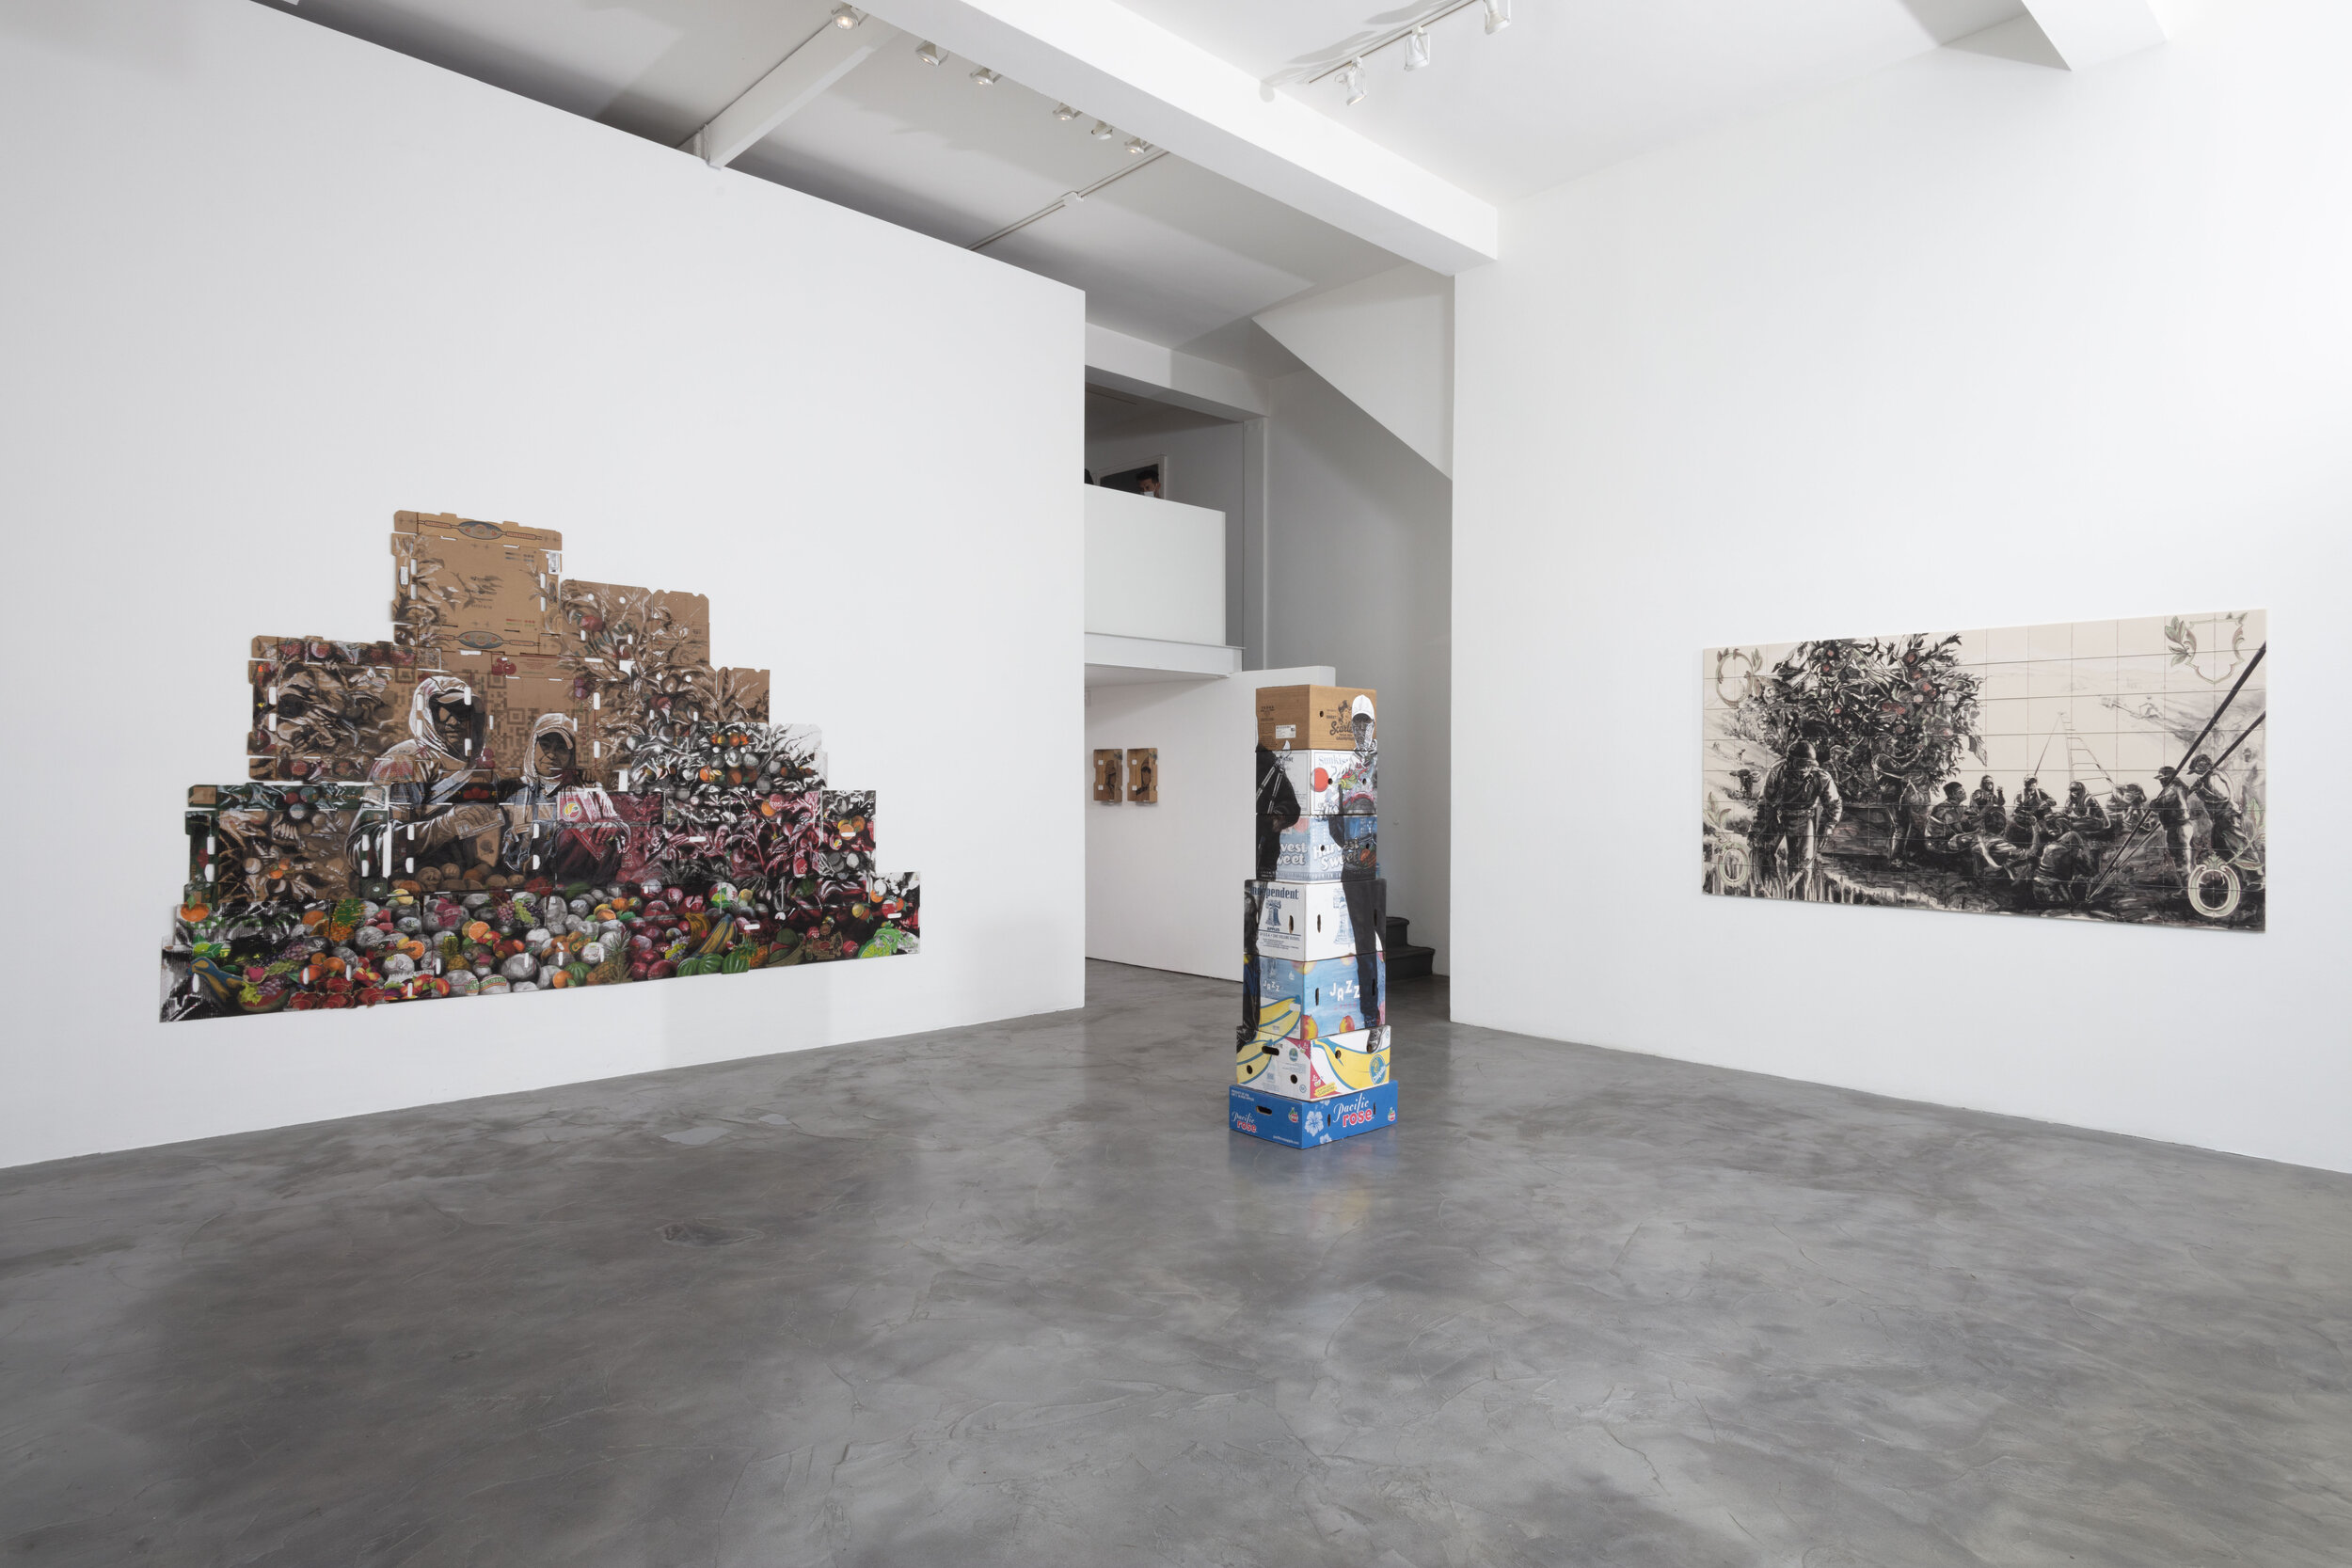
Notes:
Superfresh, installation view
https://www.cjamesgallery.com/exhibitions/superfresh

Slide 17
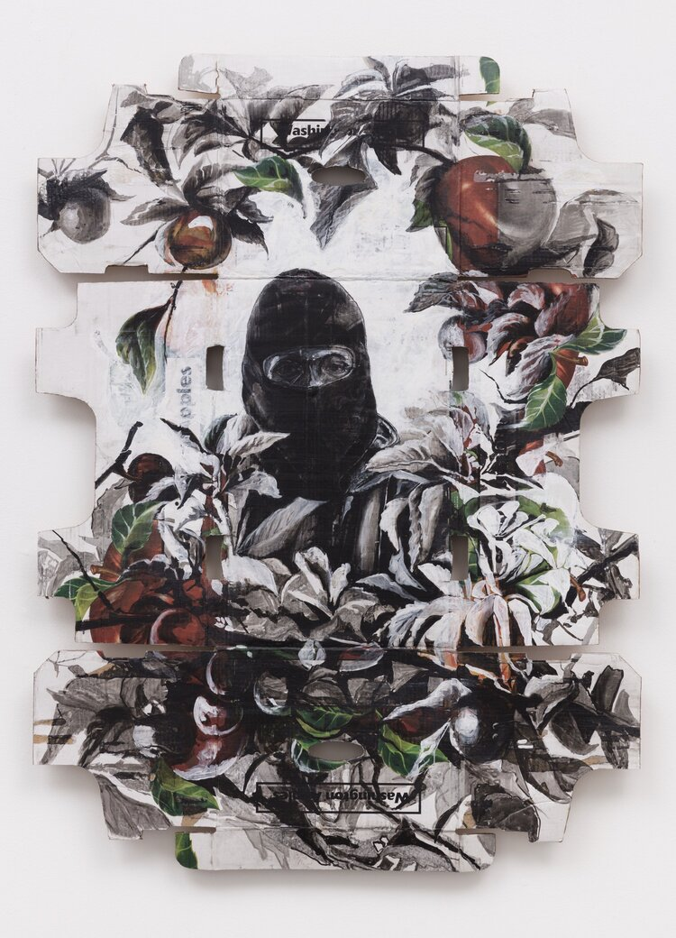
Notes:
No Stranger, 2019

Slide 18
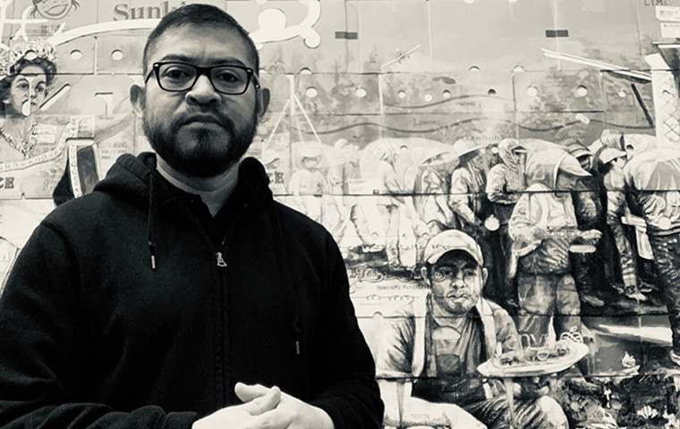
“There’s already progress because we are acknowledging them [farmworkers], and we’re seeing them. I think changes happen in little steps, and I hope that this is part of it.”
Narsiso Martínez
Notes:
Image source: https://www.uncsa.edu/kenan/art-restart/narsiso-martinez.aspx
Text source: https://www.latimes.com/entertainment-arts/story/2019-09-11/narsiso-martinez-long-beach-museum-of-art-downtown

Slide 19
Brainstorming and Designing
Think of a social justice issue important to you and/or your community
Brainstorm 5-10 items that are typically discarded that you could use to create an artwork about the issue
Sketch a simple design of your proposed artwork

