Slide 1
Zora J. Murff:
“Complicated Grace”
Notes:
Source: https://tucollegian.org/zora-j-murff-photos-tackle-intersectionality/
Note to the teacher:
Murff’s mentor used the term “complicated grace” to describe some of his work. This, Murff believes, reflects his need to center his work on issues that are difficult to confront and discuss. He hopes viewers “read” his photography in a way that helps them think about and consider multiple perspectives.

Slide 2
What is going on in this picture?
Notes:
Using a combined Visual Thinking Strategies approach and stratified questioning, guide analysis and discussion of the image:
What’s going on in this picture?
What do you see that makes you say that?
What else can we find?
When did this take place?
What kind of gathering or event might this have been?
The photographer-artist, Zora J. Murff, took a photo of a photo…this image is a cropped version of the original photo. What do you think Murff cropped? Why?
What are the differences between photojournalism and photography as art?

Slide 3
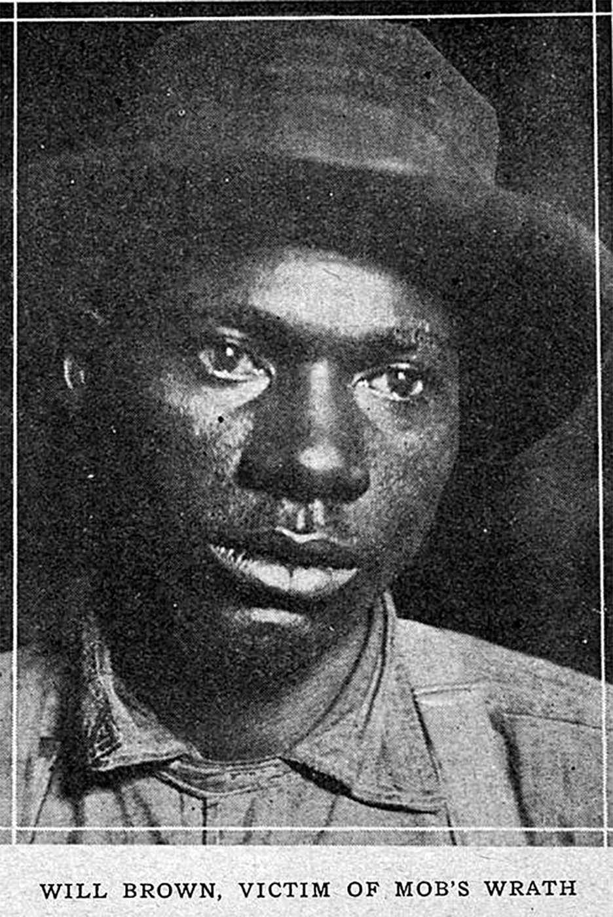
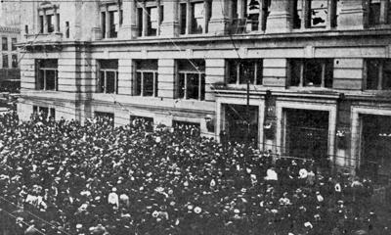
William Brown
Notes:
In Omaha, NE, on September 28, 1919, a white lynch mob formed after word spread that a white woman, Agnes Loebeck, accused a Black man, Will Brown, of raping her. The news reported that Loebeck and her fiancé alerted the police that they were assaulted on the evening of September 25. Loebeck identified the 40-year-old Will Brown as her attacker after police brought Brown to her home. A lynch mob gathered outside her house and tried to take him, but law enforcement managed to get Brown away from the vigilantes and to the courthouse jail.
But the mob did not disperse and a group of youths gathered in south Omaha and began a march to the Douglas County courthouse. Eventually, thousands of angry people gathered at the courthouse and by evening, the Omaha police and city officials inside the courthouse were virtual prisoners. The size of the crowd was estimated as between 5,000 and 15,000 people. By 8:00 p.m. the mob had begun firing on the courthouse with guns they looted from nearby stores. In that exchange of gunfire, one 16-year-old leader of the mob, and a 34-year-old businessman a block away were killed. By 8:30 the mob had set fire to the building and prevented fire fighters from extinguishing the flames. Inside, Will Brown moaned to Sheriff Mike Clark, “I am innocent, I never did it, my God I am innocent.”
The mayor tried to reason with the mob, but the white terrorists knocked him out and moved to shoot, hang, and burn Will Brown in full view of the town. The U.S. Army arrived that evening and federal troops suppressed the mob, but they were too late to save Brown.
The Army began to arrest mob ringleaders on the basis of photographs confiscated from the public…Even though photographs identified members of the mob, all of the suspects were eventually released. (Quoted from a Nebraska Studies article about the Army’s involvement)
Image Source (William Brown): Nebraska State Historical Society via NebraskaStudies.org (“World-Herald,” 1919)
Image Source (Omaha Courthouse): https://www.omaha.com/opinion/editorial-infamous-1919-omaha-riot-still-offers-lessons/article_35395f75-0ed8-5c50-b0b2-1d239b806d15.html
Info Source: Zinn Education Project, https://www.zinnedproject.org/news/tdih/omaha-courthouse-lynching-riot

Slide 4
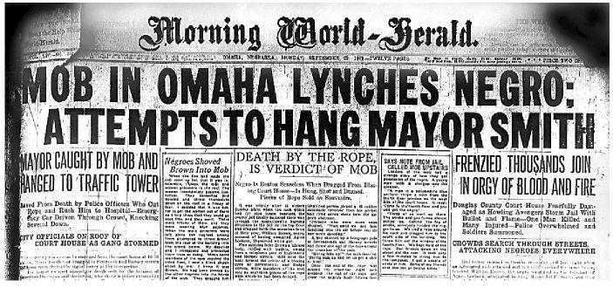
Omaha (Nebraska) Race Riot: Sept 28-29, 1919
Notes:
The Omaha race riot occurred in Omaha, Nebraska, September 28–29, 1919.
Image source: Omaha World-Herald, https://www.omaha.com/eedition/sunrise/articles/the-lynching-of-will-brown/article_9bf510b0-ba48-5664-95a9-60eb8beed866.html
From Wikipedia:
The Omaha race riot occurred in Omaha, Nebraska, September 28–29, 1919. The race riot resulted in the lynching of Will Brown, a black civilian; the death of two white rioters; the injuries of many Omaha Police Department officers and civilians, including the attempted hanging of Mayor Edward Parsons Smith; and a public rampage by thousands of white rioters who set fire to the Douglas County Courthouse in downtown Omaha. It followed more than 20 race riots that occurred in major industrial cities of the United States during the Red Summer of 1919.

Slide 5
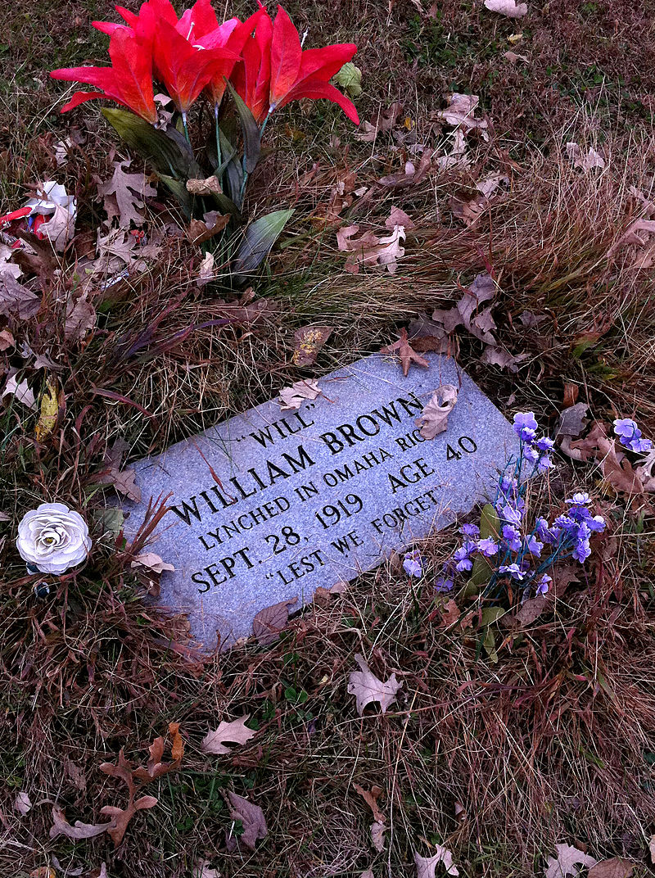
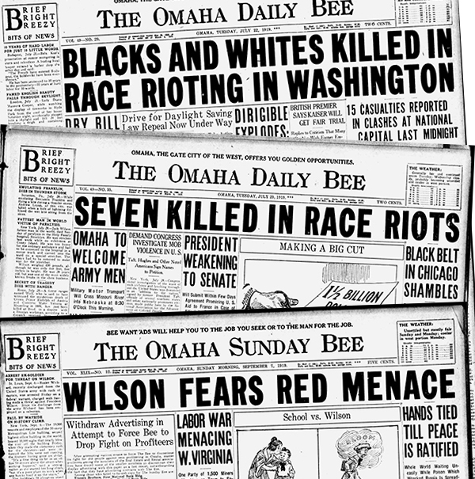
William Brown
Notes:
Image source: https://history.nebraska.gov/blog/omaha-and-%E2%80%9Cred-summer%E2%80%9D-1919
Today William Brown’s grave serves as a grim reminder of the many lives lost during the Red Summer of 1919.

Slide 6
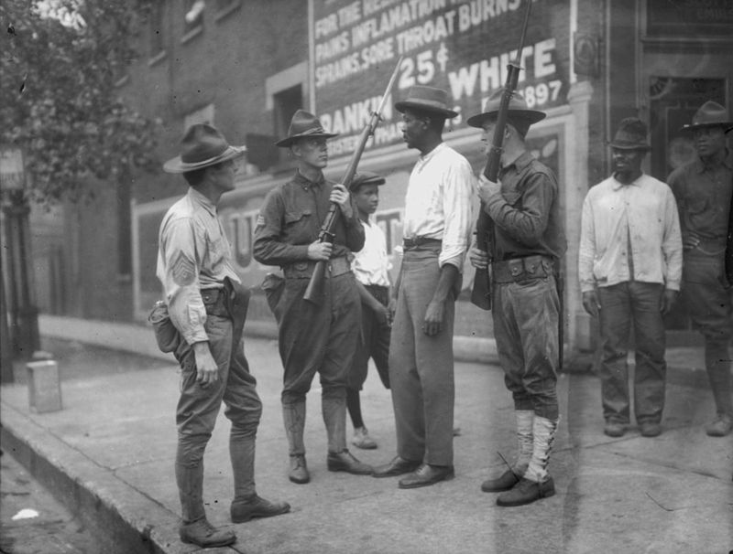
“Red Summer,” 1919
Violence against African Americans during the summer of 1919
Series of riots in various cities
Called the “Red Summer” by NAACP field secretary James Weldon Johnson referring to the blood that was shed
Notes:
The “Red Summer” of 1919 is one of the little-known events in American history that photographer-artist Zora J. Murff seeks to bring to light, exploring how these events continue to have an impact in our society today.
Info Source: https://time.com/5636454/what-is-red-summer/
Image Source: https://time.com/5636454/what-is-red-summer/
National Guardsmen question an African-American man in Chicago, after Mayor 'Big Bill' Thompson called in the National Guard on July 30, 1919, after three days of rioting.

Slide 7
Zora J. Murff:
“Complicated Grace”
Notes:
Source: https://tucollegian.org/zora-j-murff-photos-tackle-intersectionality/
Note to the teacher:
Murff’s mentor used the term “complicated grace” to describe some of his work. This, Murff believes, reflects his need to center his work on issues that are difficult to confront and discuss. He hopes viewers “read” his photography in a way that helps them think about and consider multiple perspectives.

Slide 8
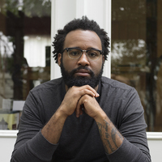
Zora J. Murff: Brief Biography
MFA in Studio Art, University of Nebraska-Lincoln
BS in Psychology, Iowa State University
Aperture Portfolio Prize finalist (2019)
Light Work Artist-in-Residence (2019)
Has a number of published books:
most recent: At No Point In Between (Dais Books, 2019)
winner of a Lucie Foundation Photo Book Award
Currently:
Assistant Professor of Art at the University of Arkansas
Co-Curator of the Strange Fire Collective
Notes:
Info Source: http://www.zora-murff.com/about
Image Source: https://www.spenational.org/conferences/tahoe-colab/speakers/zora-j-murff
On his BS in Psychology (from https://aperture.org/blog/zora-murff-redlining/): Murff acknowledges that his degree in counseling and psychology has impact on his work. “When you go to see a therapist, they already know what’s wrong with you. But they understand that if you find the answer yourself, you can take ownership over it, learn from it, and grow from it.”
Murff is Co-Curator of Strange Fire Collective, a group of interdisciplinary artists, writers, and curators working to promote and construct an archive of artwork created by women, people of color, and LGBTQ+ individuals.

Slide 9
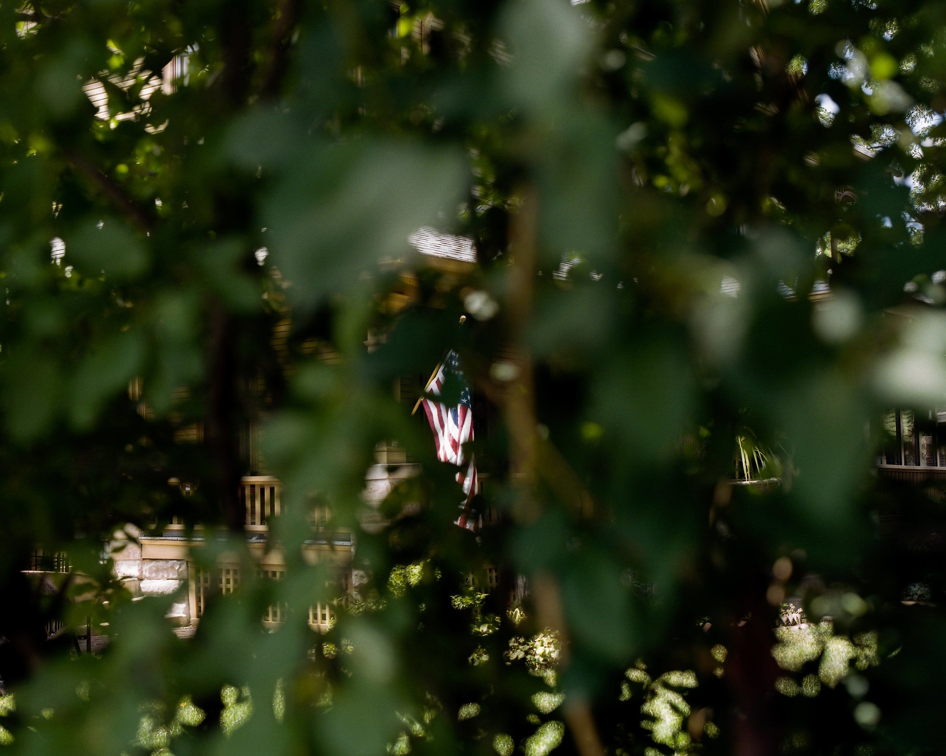
Central themes of Murff’s work
Photography as a way to explore histories of American systems
The role imagery plays in shaping our beliefs
The ability of photography to tell stories and histories that are beyond verbal language.
From the series: American Mother, American Father
Notes:
Info Source: http://www.zora-murff.com/about
Image Source: http://www.zora-murff.com/american-mother-american-father

Slide 10
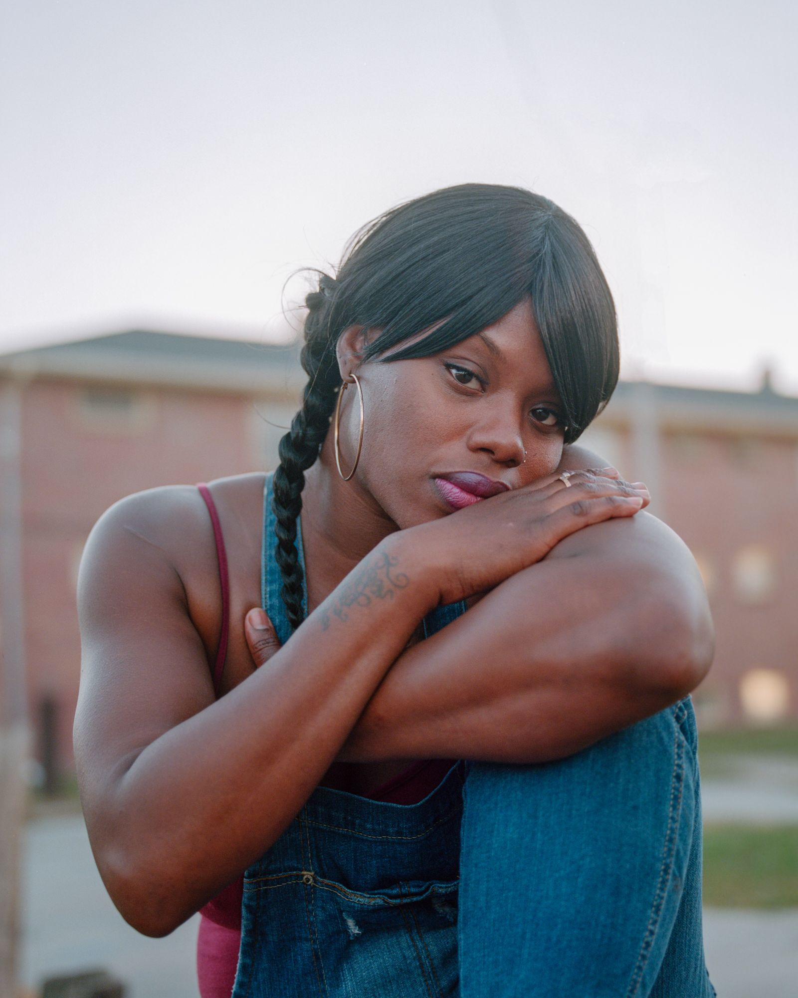
Concepts in Murff’s work
From the series: At No Point in Between
Notes:
Image Source: https://www.lensculture.com/articles/zora-murff-at-no-point-in-between
From The Collegian (https://tucollegian.org/zora-j-murff-photos-tackle-intersectionality/): Murff drew on an idea from Harvard English professor Robert Nixon called “slow violence” to describe the long term effects of segregation. There are two kinds of violence, Murff outlined. “Fast violence” is easy to recognize because it takes the shape of physical pain. “Slow violence,” on the other hand, has more space between actions and their consequences.

Slide 11
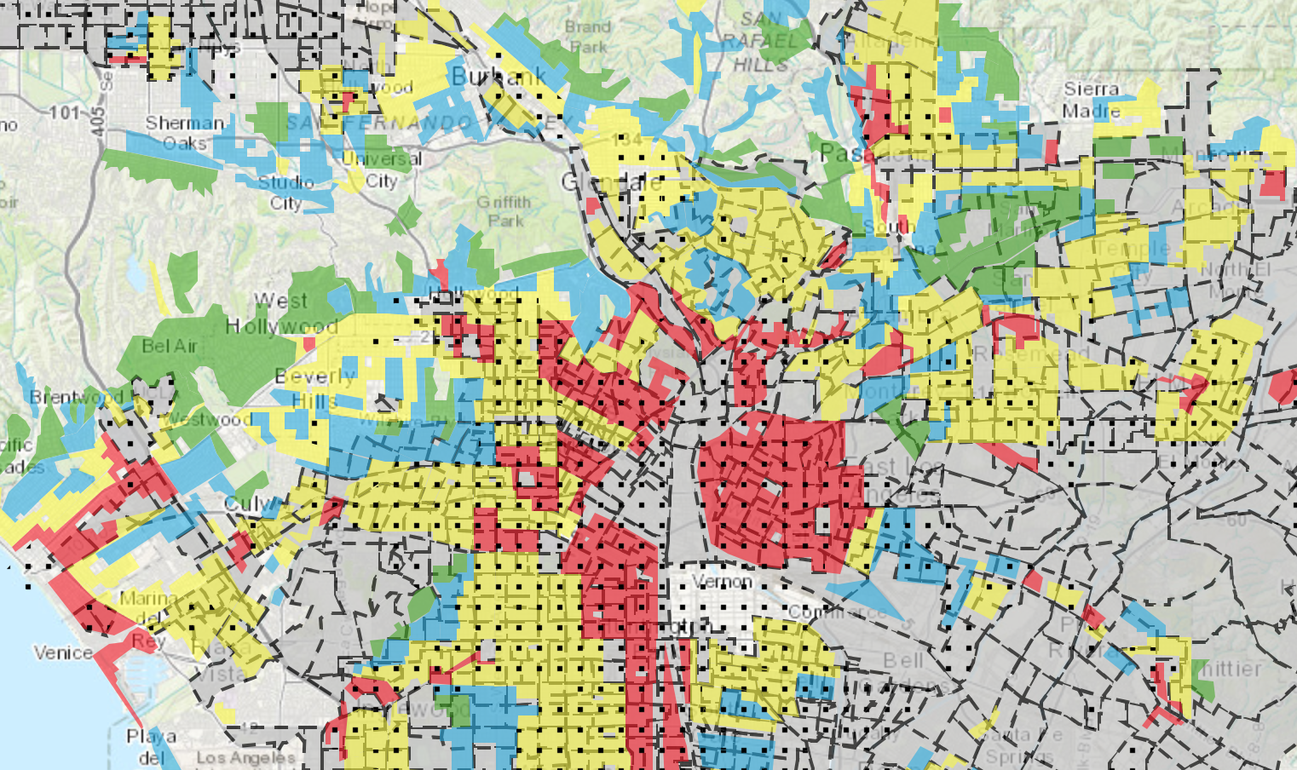
Redlining and “Slow” Violence
systematically denying services (e.g., banking, insurance, health care, fresh food) to residents of specific communities, often on the basis of race
“redlining” was coined by the sociologist John McKnight in the 1960s
the term is derived from the act of drawing a red line on a map
Murff highlights connections between slow violence (such as redlining), and more overt racial violence, such as lynching
Notes:
Info Source: https://artmuseum.colostate.edu/events/zora-murff-artist-talk/
The practice of redlining was coined by the sociologist John McKnight in the 1960s. The term “redlining” describes the practice of systematically denying services—such as access to banking, insurance, health care, or fresh food—to residents of specific communities, often on the basis of race. The name is derived from the act of drawing a red line on a map. Murff highlights connections between the systemic racism like redlining, and more overt racial violence, such as lynching.
From The Collegian (https://tucollegian.org/zora-j-murff-photos-tackle-intersectionality/): Murff drew on an idea from Harvard English professor Robert Nixon called “slow violence” to describe the long term effects of segregation. There are two kinds of violence, Murff outlined. “Fast violence” is easy to recognize because it takes the shape of physical pain. “Slow violence,” on the other hand, has more space between actions and their consequences.

Slide 12
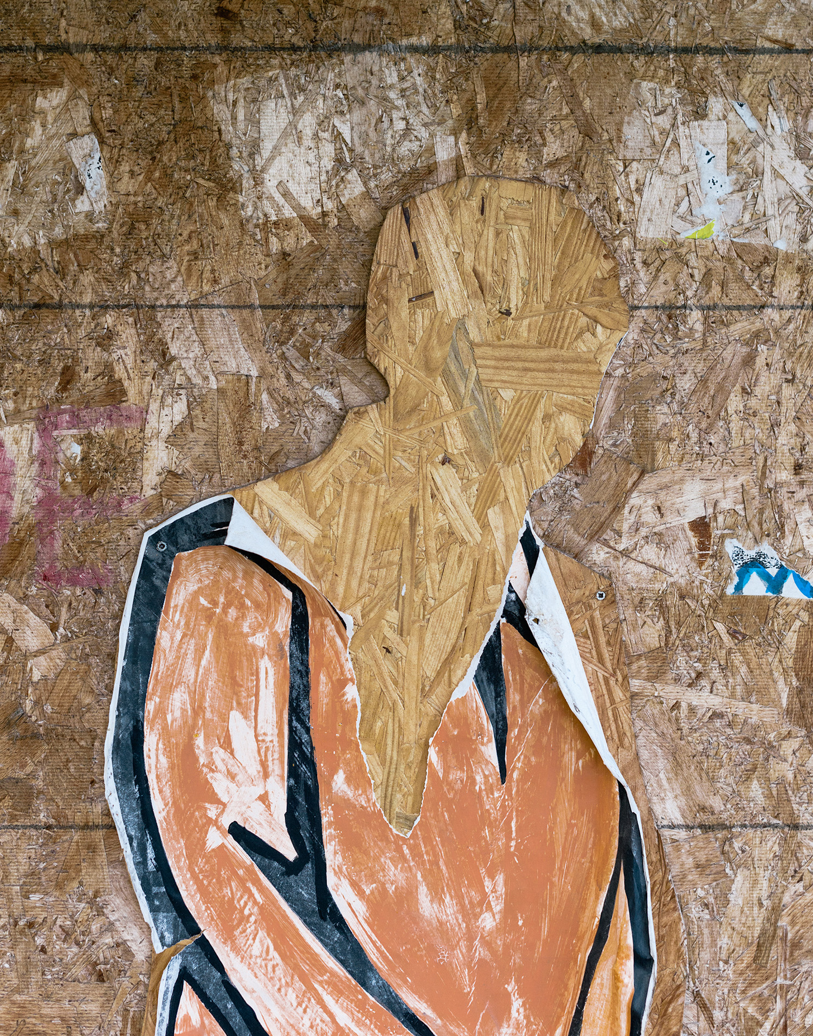
“Stripped” (At No Point in Between, 2019)
Notes:
What is the overall tone/emotion conveyed by this work?
Why do you think the artist entitled it “Stripped”?
What do you think was stripped from the person in the work?
What do you think the material might have to do with the meaning?
How might this image portray the concept of “slow violence”?
How does the material of the artwork support the concept?

Slide 13
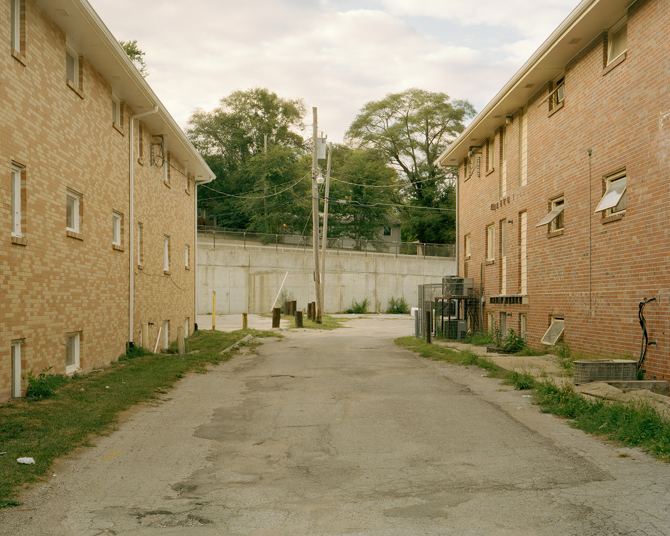
Imagine you are a resident in this community…
Notes:
What sounds are you likely to hear?
What services might you ask for?
Do you think the government has a responsibility for the condition of this residential complex?
How might untended housing reflect “slow violence”?
Image Source: https://aperture.org/blog/zora-murff-redlining/

Slide 14
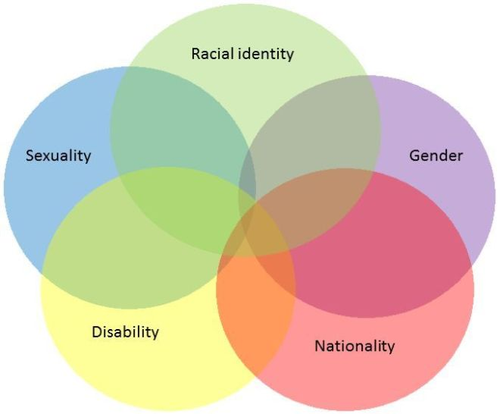
Intersectionality
Intersectionality: the interconnections of social categories (e.g., race, class, gender, sexual orientation, religion) that often result in discrimination or disadvantage
Notes:
Image source: https://disabilitydevelopment.com/2018/11/29/intersectionality-in-development-2/

Slide 15
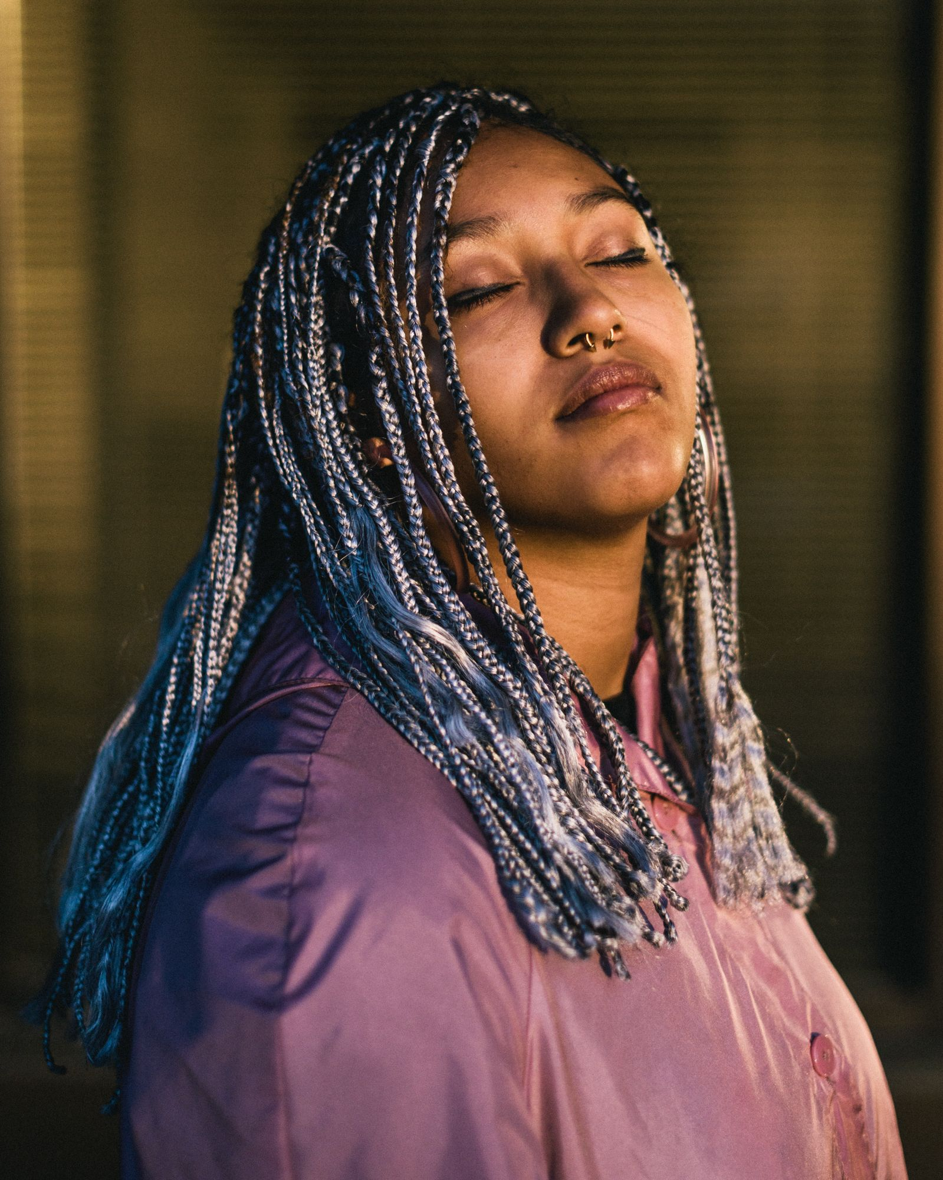
“Thalia (talking about Us)” At No Point in Between, 2019
Notes:
Image source: https://hcponline.org/spot/on-redlining-and-photographys-objectivity/

Slide 16
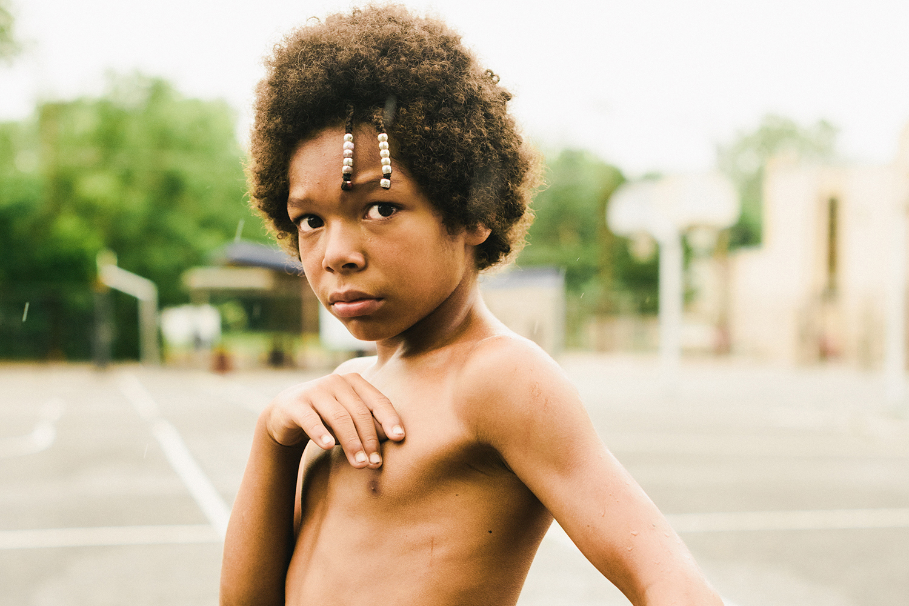
“Young Man (talking about his future)” From the series: At No Point in Between, 2019
Notes:
How do you feel about your future?

Slide 17
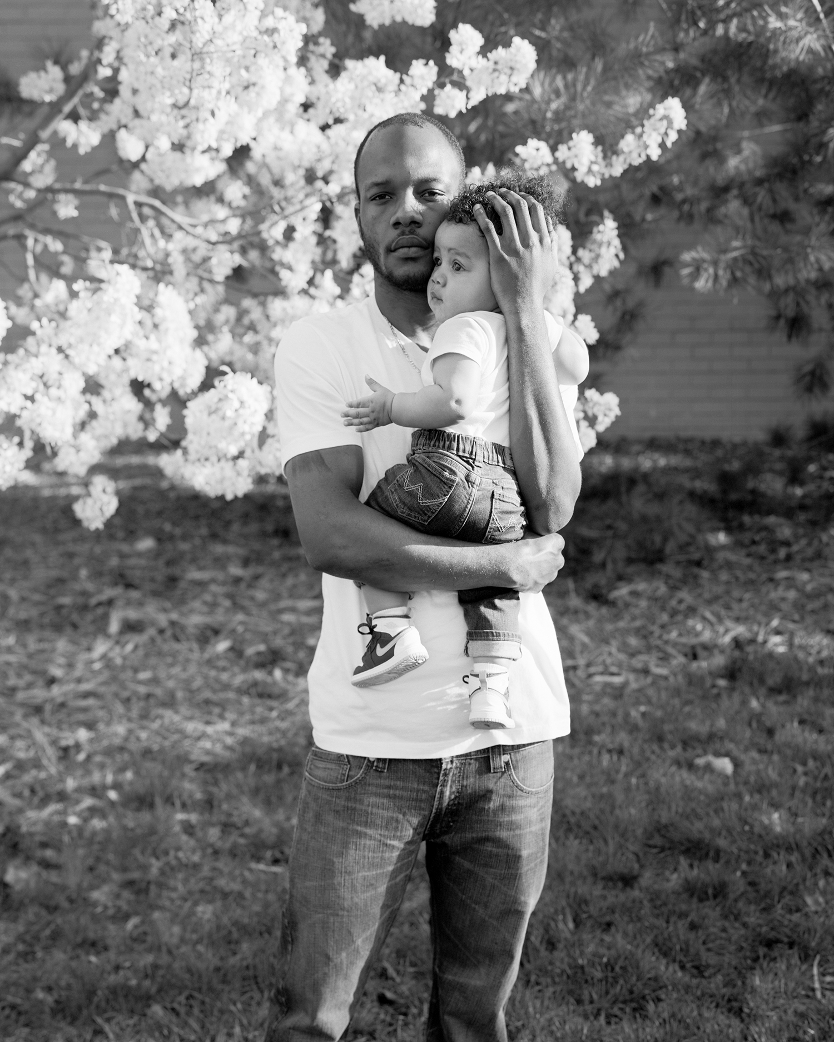
“Jerrod and Junior (talking about fatherhood)” From the series: At No Point in Between, 2019
Notes:
How does this image express fatherhood?

Slide 18
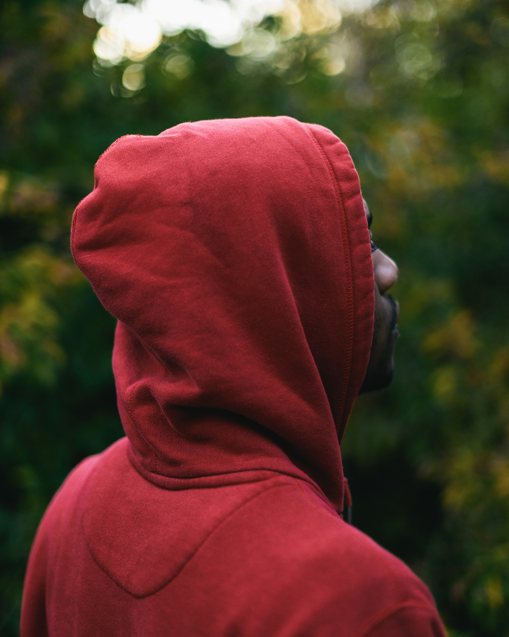
“Jerrod (talking about hoods)” From the series: At No Point in Between, 2019
Notes:
Why are we talking about hoods?
How is the "hood" historically related to racism? Can you think of any associated recent events?

Slide 19
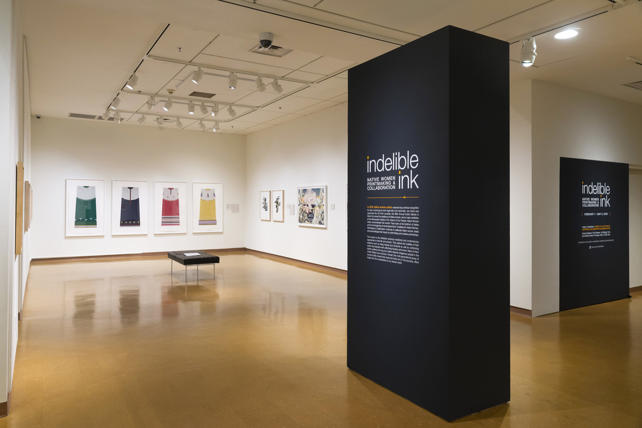
Strange Fire Collective

Slide 20
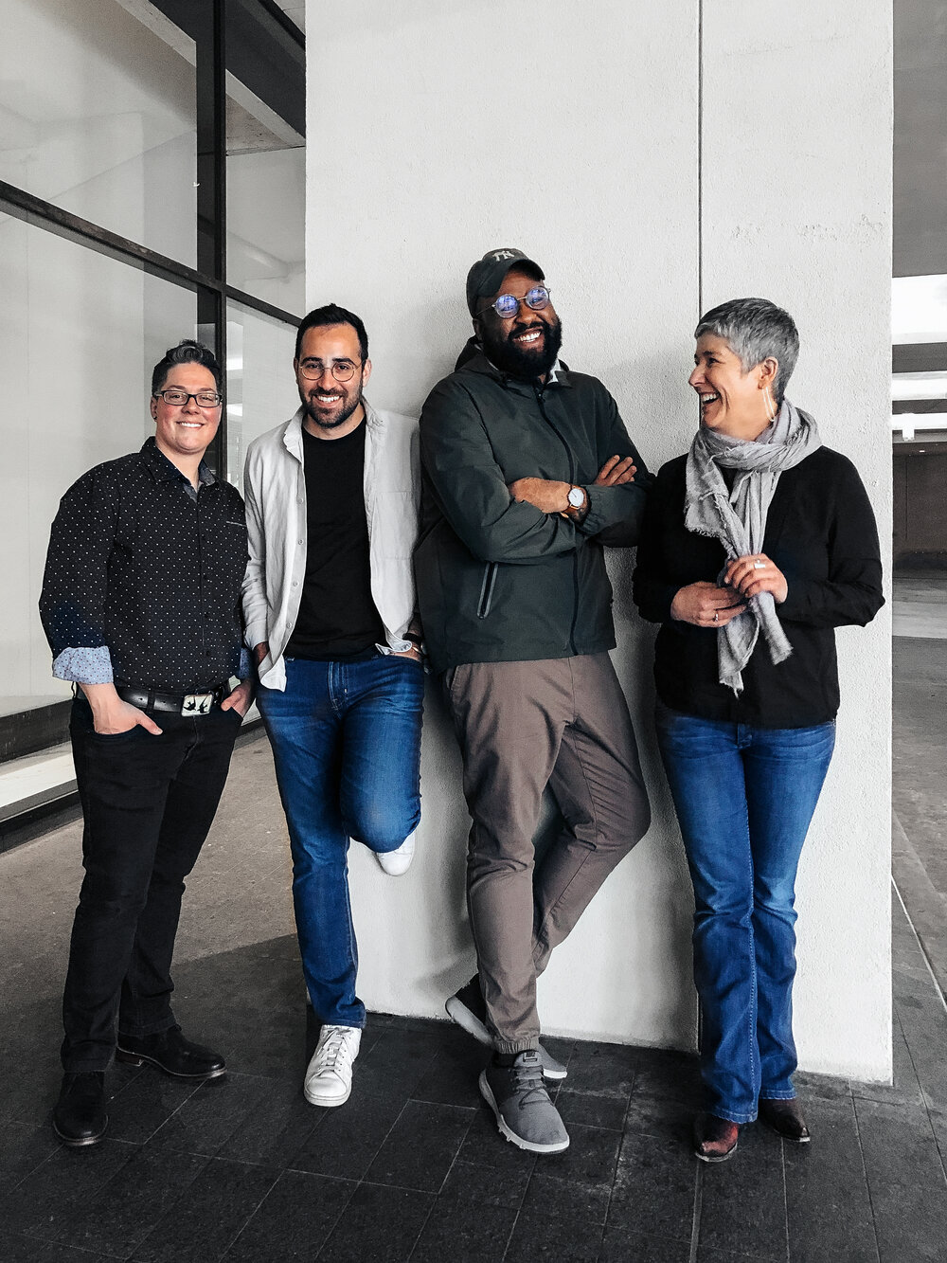
Strange Fire artist collective (formed in 2015)
Group of interdisciplinary artists, curators, & writers focused on work centered on current social and political issues
Critically questions the dominant social hierarchy
Dedicated to highlighting work made by women, people of color, and LGBTQ artists
Publishes and hosts publications, exhibitions, and community events
Committed to making projects accessible, affordable, and socially relevant
Notes:
Info Source: http://www.zora-murff.com/strange-fire-collective
Image Source: http://www.strangefirecollective.com/about
Strange Fire was formed in 2015 by Jess T. Dugan, Rafael Soldi, Zora J. Murff, and Hamidah Glasgow.

Slide 21
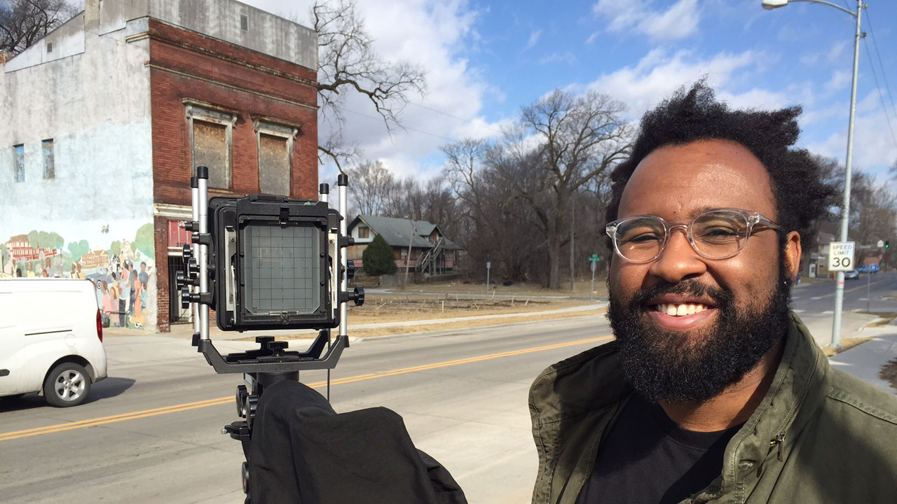
Documenting our realities
Notes:
Image source: https://artmuseum.colostate.edu/events/zora-murff-artist-talk/

